Slide 1

Vanguard
Geospatial Analysis with QGIS, Python & R
1 – 3 Sep 2021

Slide 2

Notes:
Hello everyone! Welcome to the course: QGIS Vanguard! it’s great to have you here.
My name is Hengshan. I am a geospatial analyst. I started my career as a GIS software developer and then pursued my Ph.D. in spatial information science and engineering from the University of Maine in the U.S.. After that, I joined Singapore-ETH center and worked as a postdoc researcher focusing on spatial cognition and indoor navigation. With work experience in both software development and in academia, I can see geo-spatial analysis from different perspectives, and I am very excited to have this opportunity to share it with you.
Today, my colleagues Kim Haw and Tack Guan join in us to be your facilitators. Both KH and TG have many many years experience in GIS, geospatial analytics, and QGIS training. some of you might have taken part in their QGIS courses.
To start off, can everyone share with us your name, professional background and prior experience on geo-spatial analysis.

Slide 3



Vanguard
What you will learn
Use QGIS Python Library (PyQGIS) to Query, Visualize, and Process Geospatial Data (Day 1)
Use PySAL & spreg for Spatial Regression (Day 2)
Use SciKit-Gstat for Geostatistics (Day 3)
@
Notes:
This course will get you up and running with geospatial analysis using QGIS and Python.

Slide 4
Vanguard
Day 1
Day 2
Day 3
Session 1
Session 3
Session 5
QGIS Python console
Quick intro. to Python
Intro. to PyQGIS
Spatial Auto-correlation
Spatial Weights
Intro. to Spatial regression models
Intro. to Geostatistics
Variogram
Kriging
Session 2
Session 4
Session 6
Load vector layer
Query & Filter
Join % Spatial Join
Create Processing & Plugin
Autocovariate regression
Spatial eigenvector mapping
Autoregressive models
Spatial generalized estimating equations (GEE)
Project Session
@
Notes:
Starting from software setup and working environment setup. Followed up with customizing and automating the Geospatial Workflow.
You will be interacting with a wide range of spatial
data, including remote sensing and vector raster data sets.
In Section 2 you will learn how to query for point cloud data and create a 3D map.
In Section 3 you will then be able to distinguish vector and raster layers and use a variety of geospatial tools to process them and extract information over large data
sets for problem solving.
Continuing on in sections four you will familiarize with and learn to download an process. Remote sensing data acquired from satellites.
Understand remote sensing theories and obtain terrain Maps and digital
elevation models, and finally in the last section.
You will be provided with a variety of resources of best practices in geospatial analysis, cartography, data hunting and presenting information.

Slide 5
Vanguard
Day 1
Day 2
Day 3
Session 1
Session 3
Session 5
QGIS Python console
Quick intro. to Python
Intro. to PyQGIS
Python Packages
Spatial Auto-correlation
Spatial Weights
Create Processing & Plugin
Session 2
Session 4
Session 6
Load vector layer
Query & Filter
Join % Spatial Join
Intro. to Spatial regression models
Project Session
@
Notes:
Starting from software setup and working environment setup. Followed up with customizing and automating the Geospatial Workflow.
You will be interacting with a wide range of spatial
data, including remote sensing and vector raster data sets.
In Section 2 you will learn how to query for point cloud data and create a 3D map.
In Section 3 you will then be able to distinguish vector and raster layers and use a variety of geospatial tools to process them and extract information over large data
sets for problem solving.
Continuing on in sections four you will familiarize with and learn to download an process. Remote sensing data acquired from satellites.
Understand remote sensing theories and obtain terrain Maps and digital
elevation models, and finally in the last section.
You will be provided with a variety of resources of best practices in geospatial analysis, cartography, data hunting and presenting information.

Slide 6
Prerequisites
For geographers, engineers, developers, environmental scientists, ecologists, and GIS professionals
Basic knowledge in GIS is required
Basic programming knowledge and basic understanding about linear regression and statistics are helpful
Notes:
This course is for geographers, engineers, architects, consultants or developers and GIS professionals who want
to further their skills in Geospatial Sciences. The course is also good for young researchers on certain majors that require a strong spatial analysis foundation such as (e.g., ecology, fishery & marine science, and environmental psychology, etc.)
Basic knowledge in GIS is required (assume you’ve taken QGIS Primer or Geospatial 101.
Basic programming knowledge is helpful but not necessary.

Slide 7
References
PyQGIS Developer Cookbook
Python Cheat Sheet
PySAL open source library of spatial analysis
Spreg spatial regression models
SciKit-Gstat scipy-styled analysis module for geostatistics
Statistical Analysis Handbook
Geographic Data Science with PySAL and the PyData Stack

Slide 8
QGIS
User-friend graphic user interface (GUI)
Directly edit spatial data
Great for one time, fine-tuning work
Python
Programming/development environment
Reproducible, Iterable, automatable
Flexible and powerful
Notes:
In QGIS Primer and Cognizance, we’ve learned how to use QGIS GUI to load data, to label and to geocode data, as well as selection and aggregation and so on and so forth.
In this course, we are going to integrate user-friendly QGIS GUI and flexible and powerful programming language Python to maximize the outcome of your Geo spatial tasks.
By the end of the course, you will be able to write basic python script to interact with the geographic data and to solve realistic problems.
I hope you’re as excited as I am, and let's get started.

Slide 9
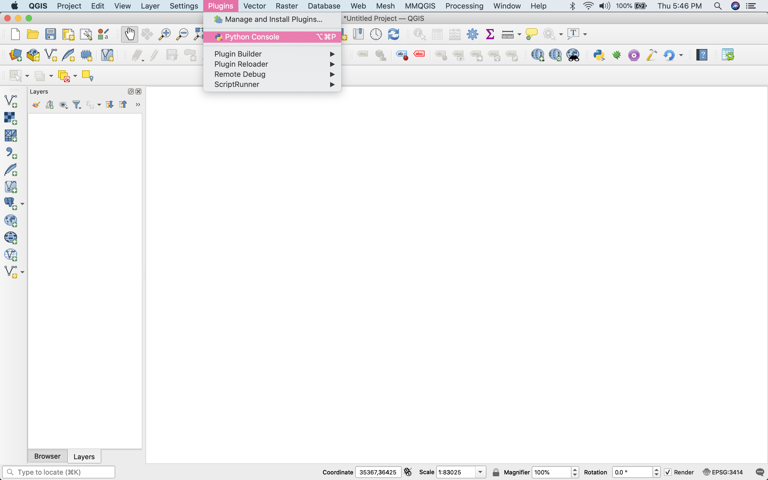

Slide 10
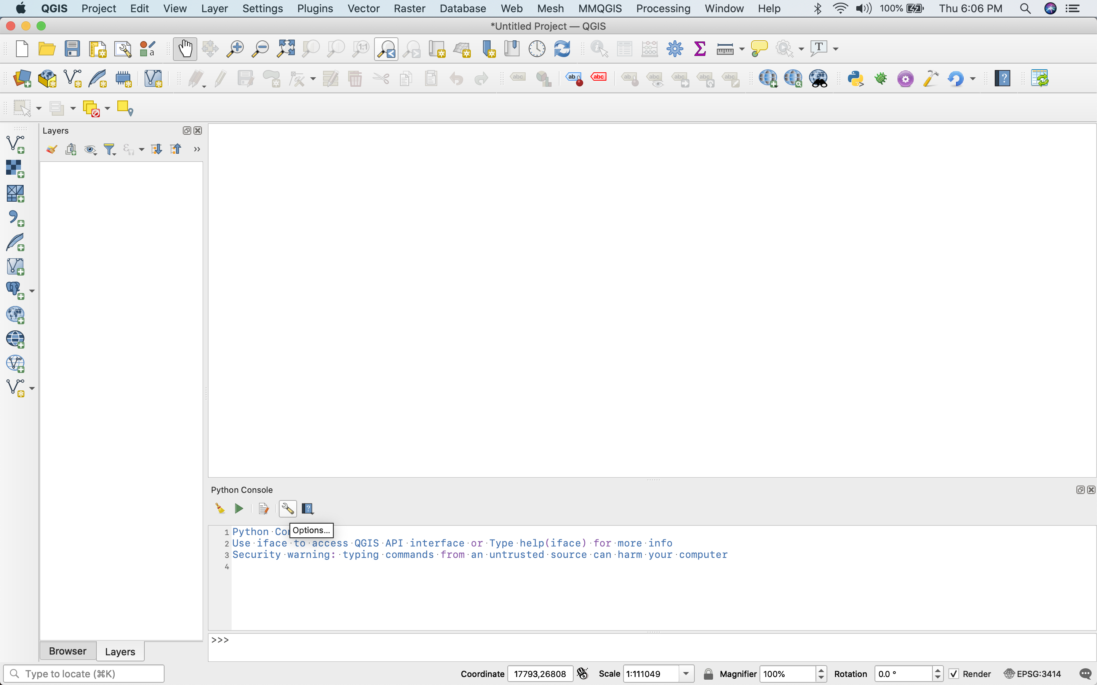
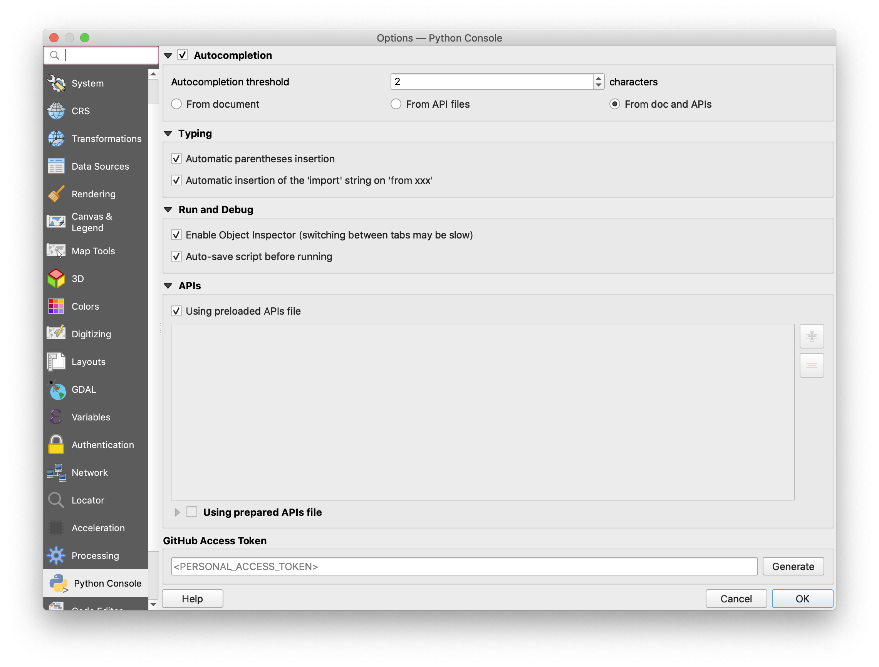

Slide 11
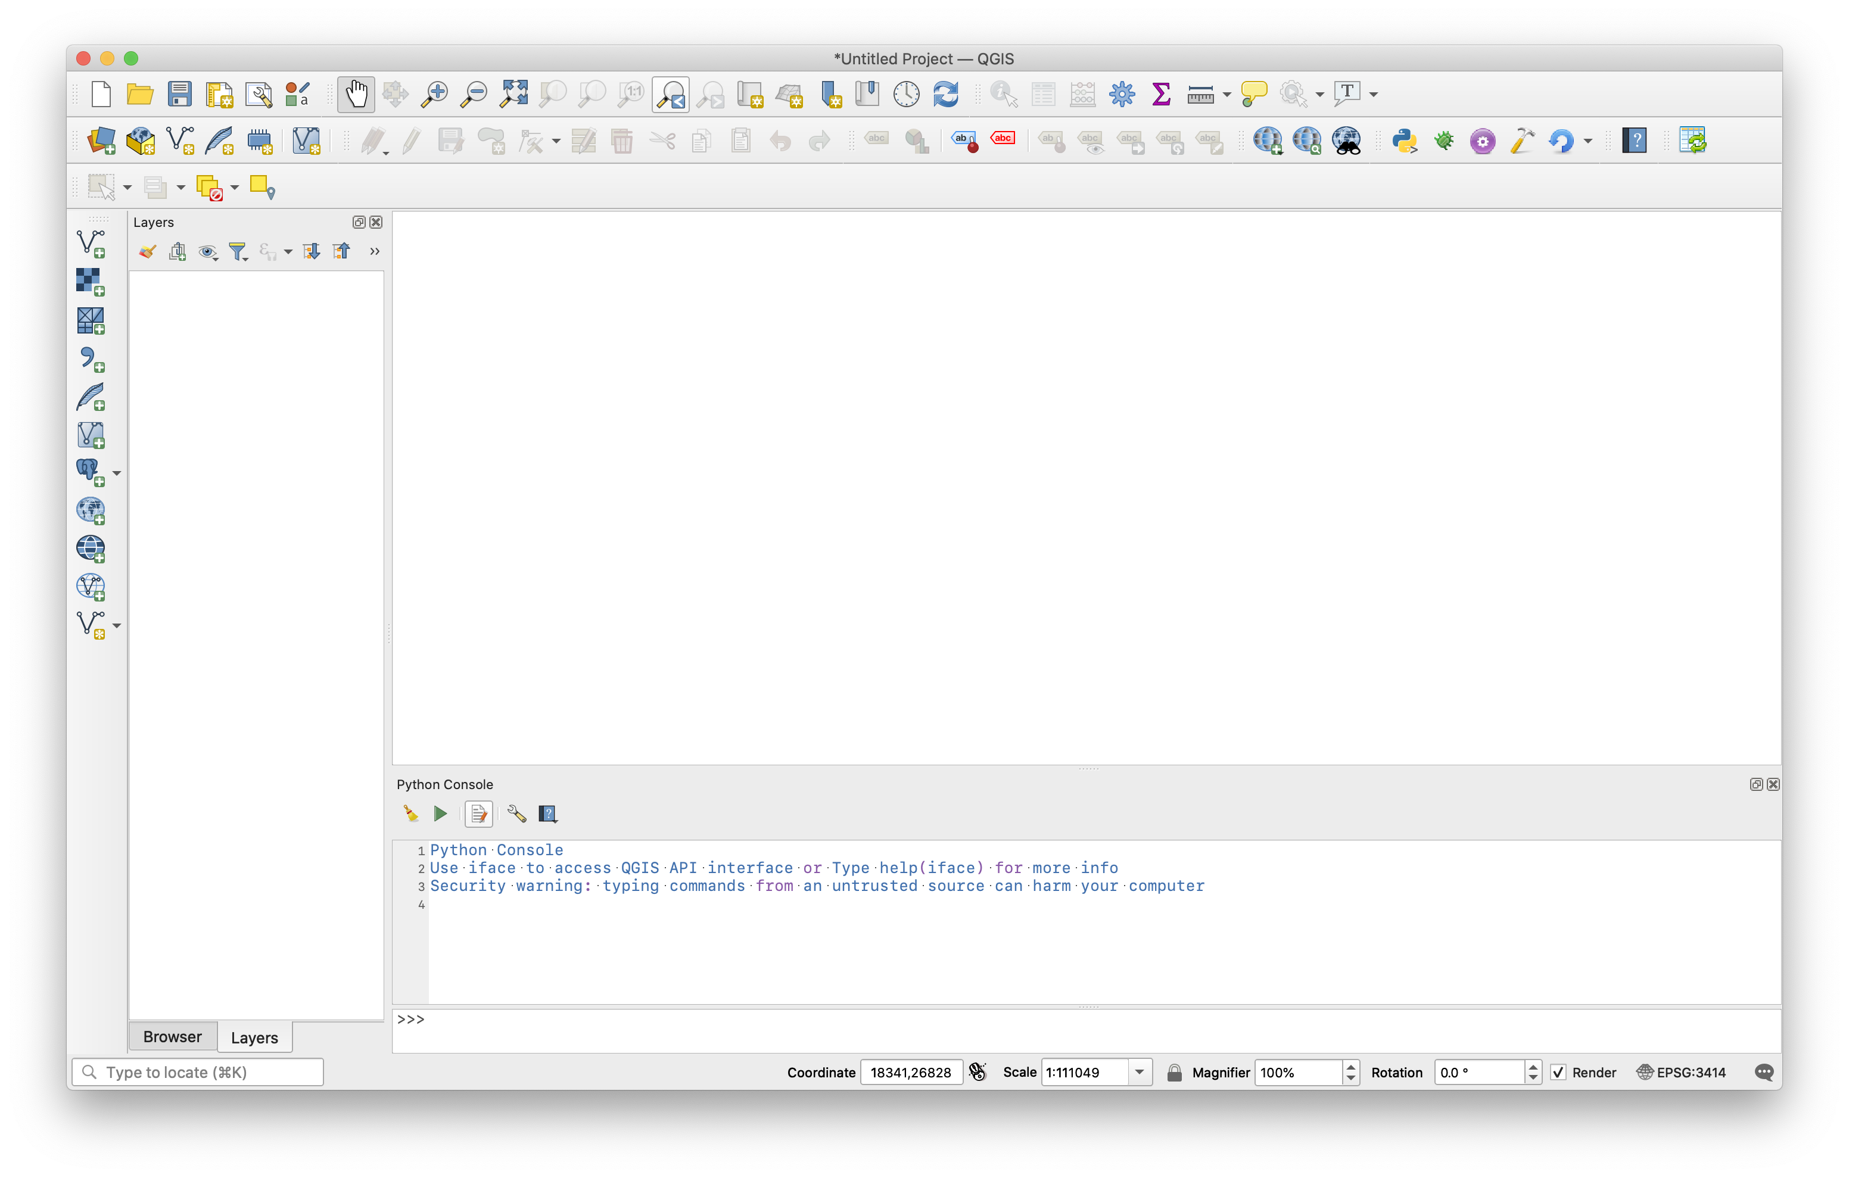
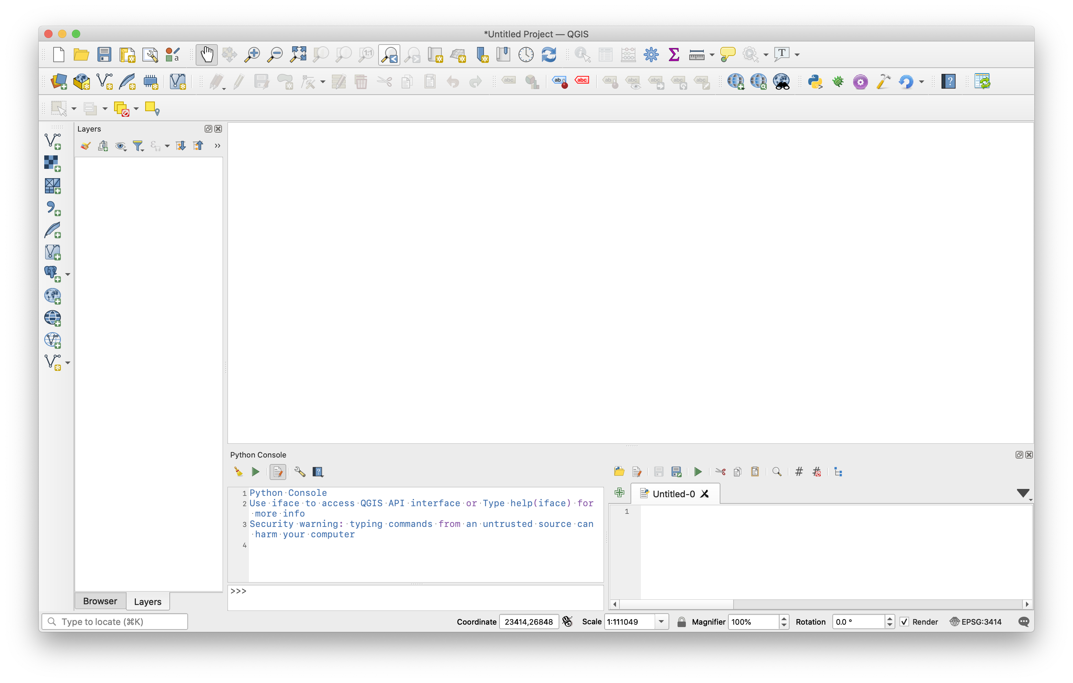

Slide 12


Slide 13
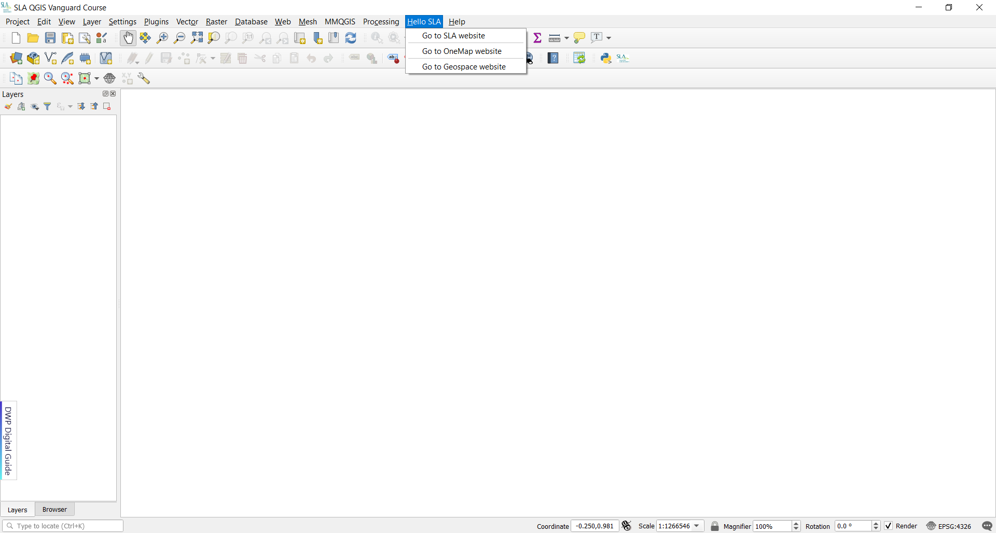

Slide 14
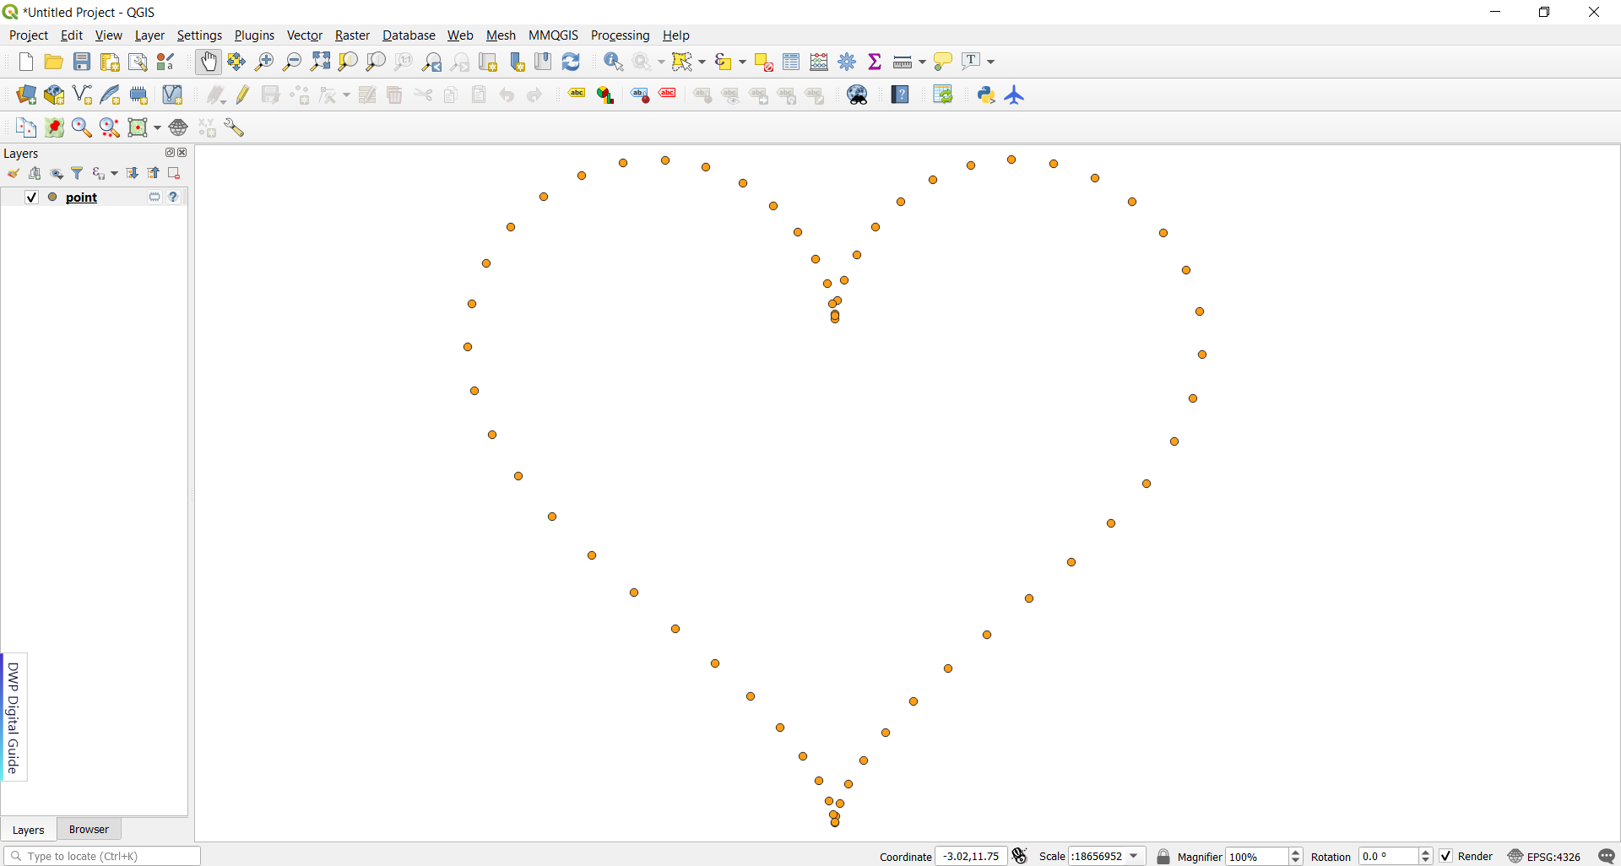
Create Heart-Shaped Points using Python

Slide 15
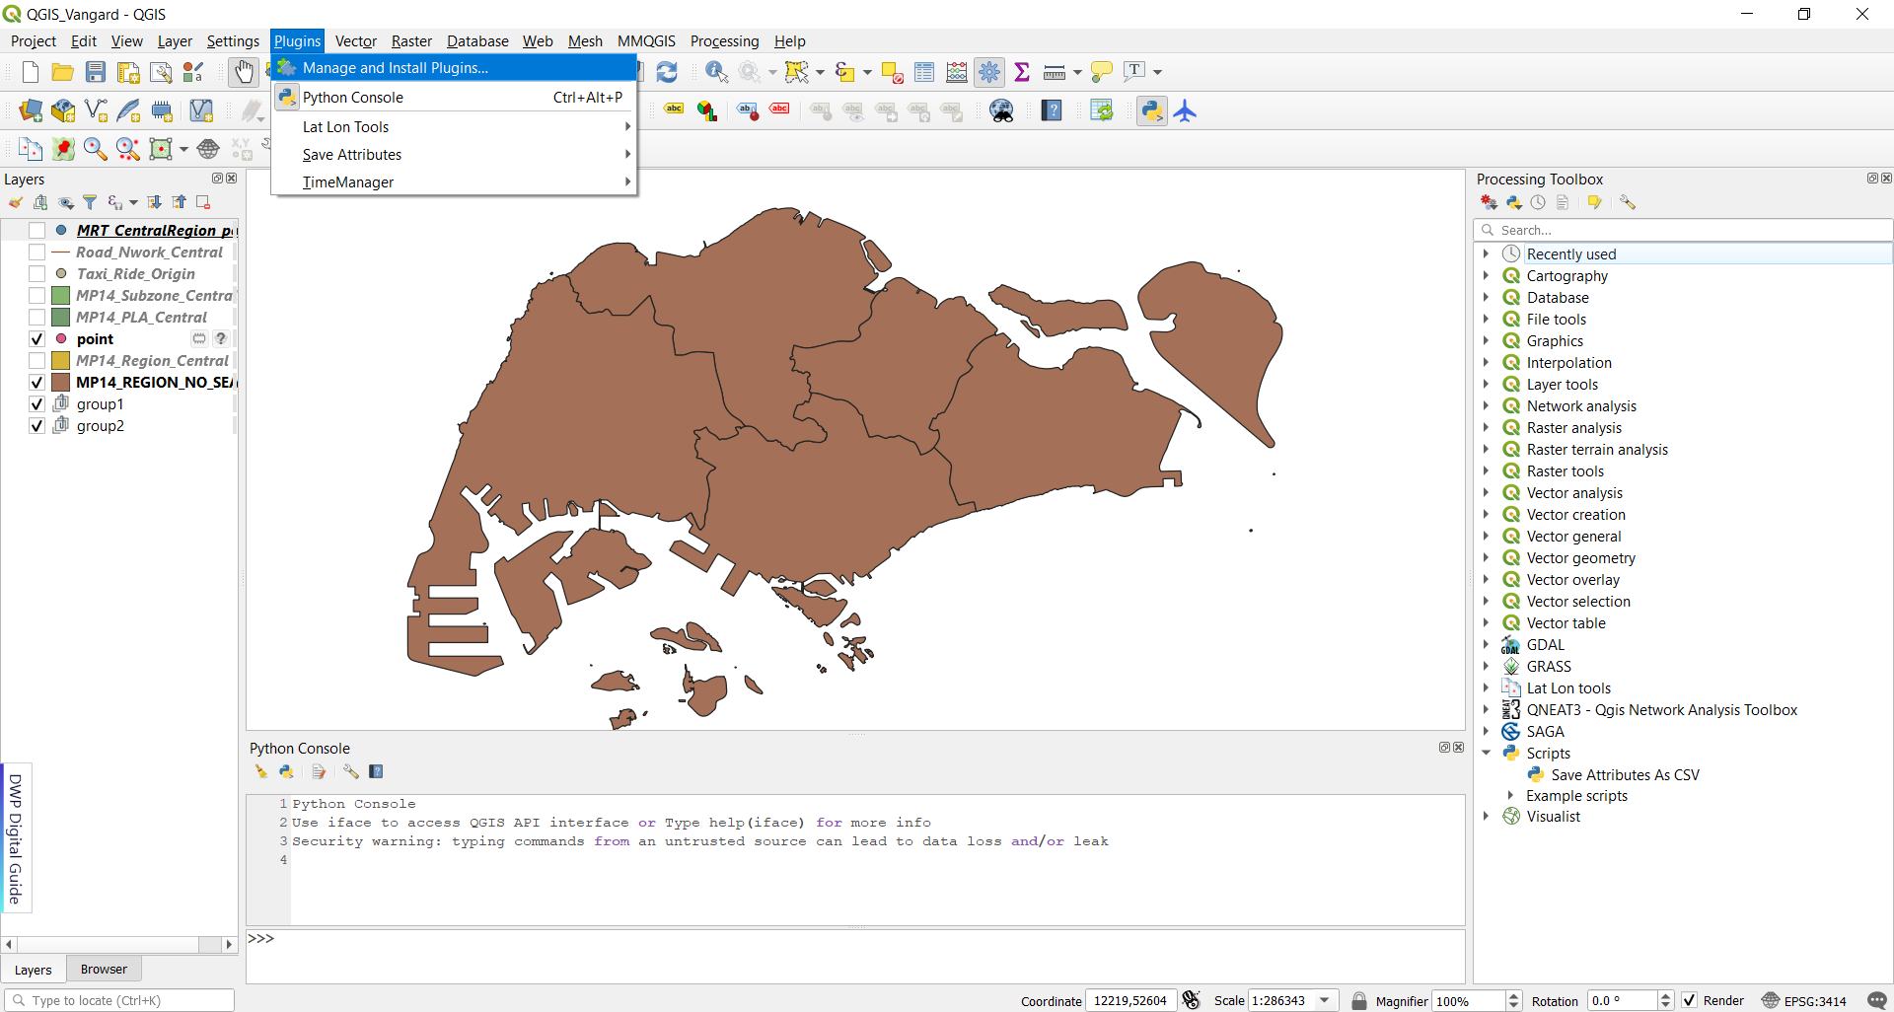
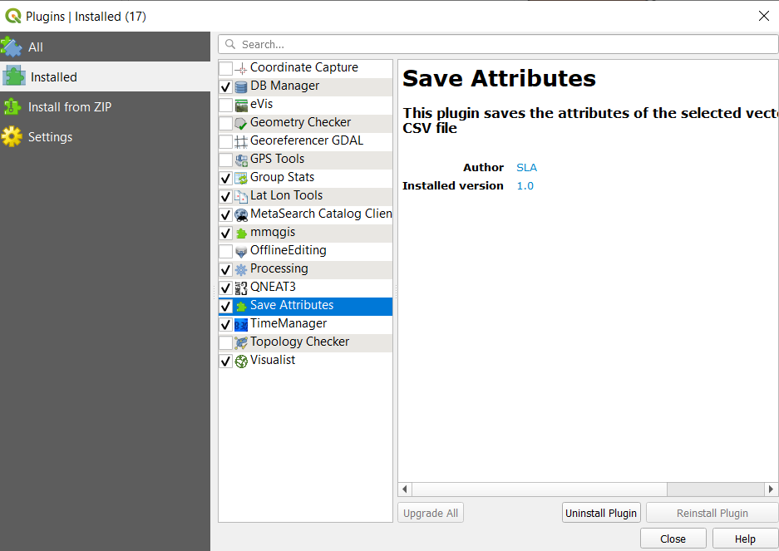
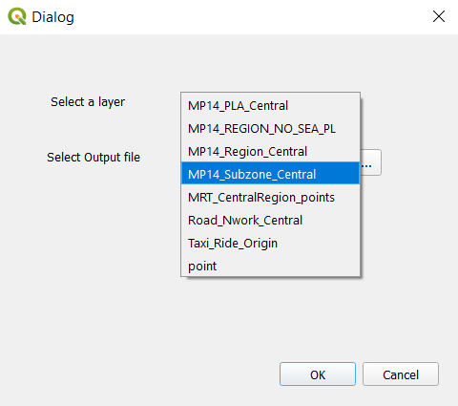
Create Plugins with Python

Slide 16
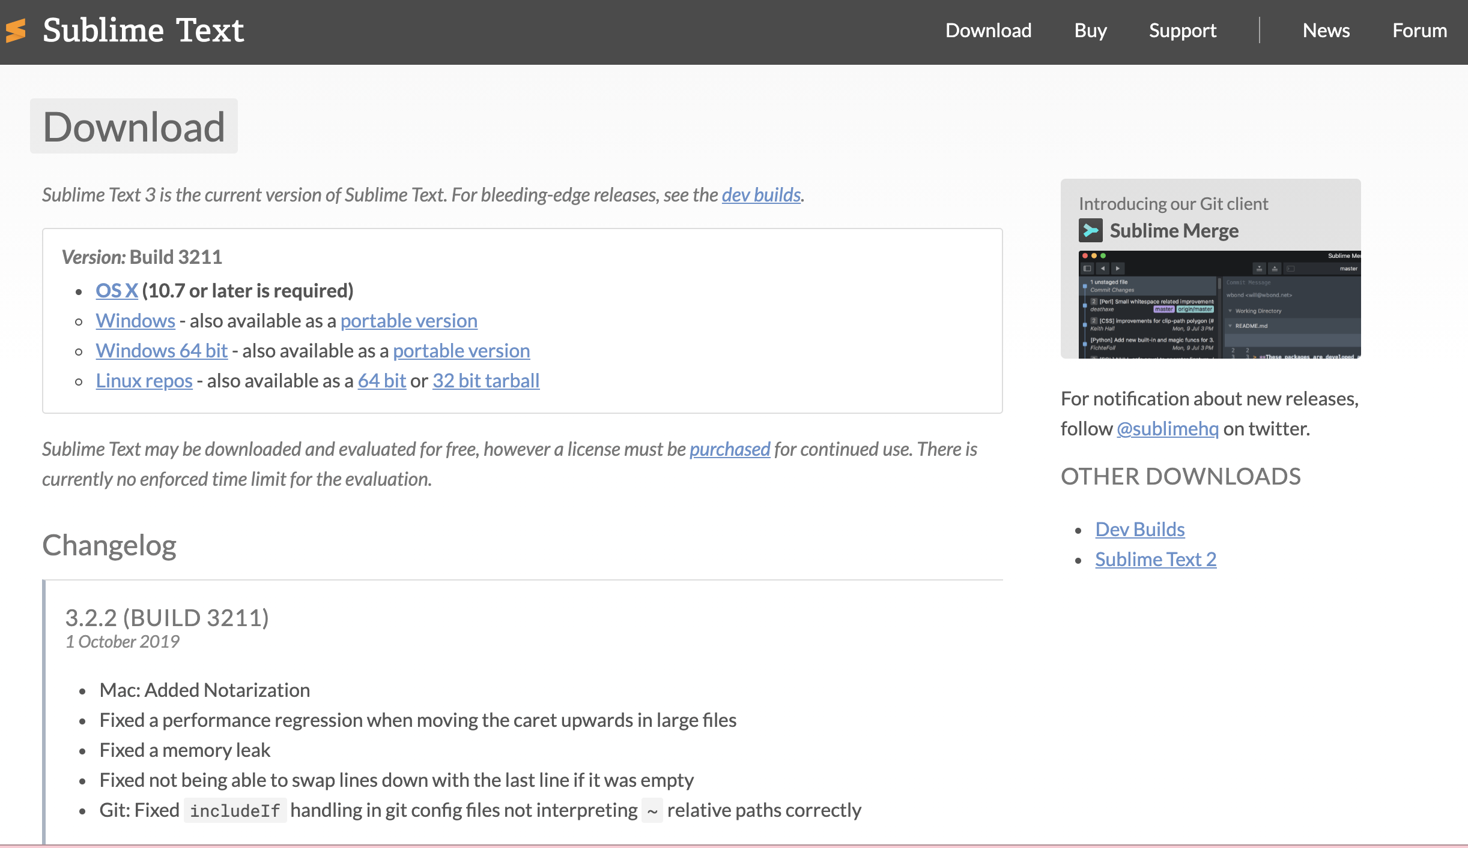
Download Sublime Text

Slide 17
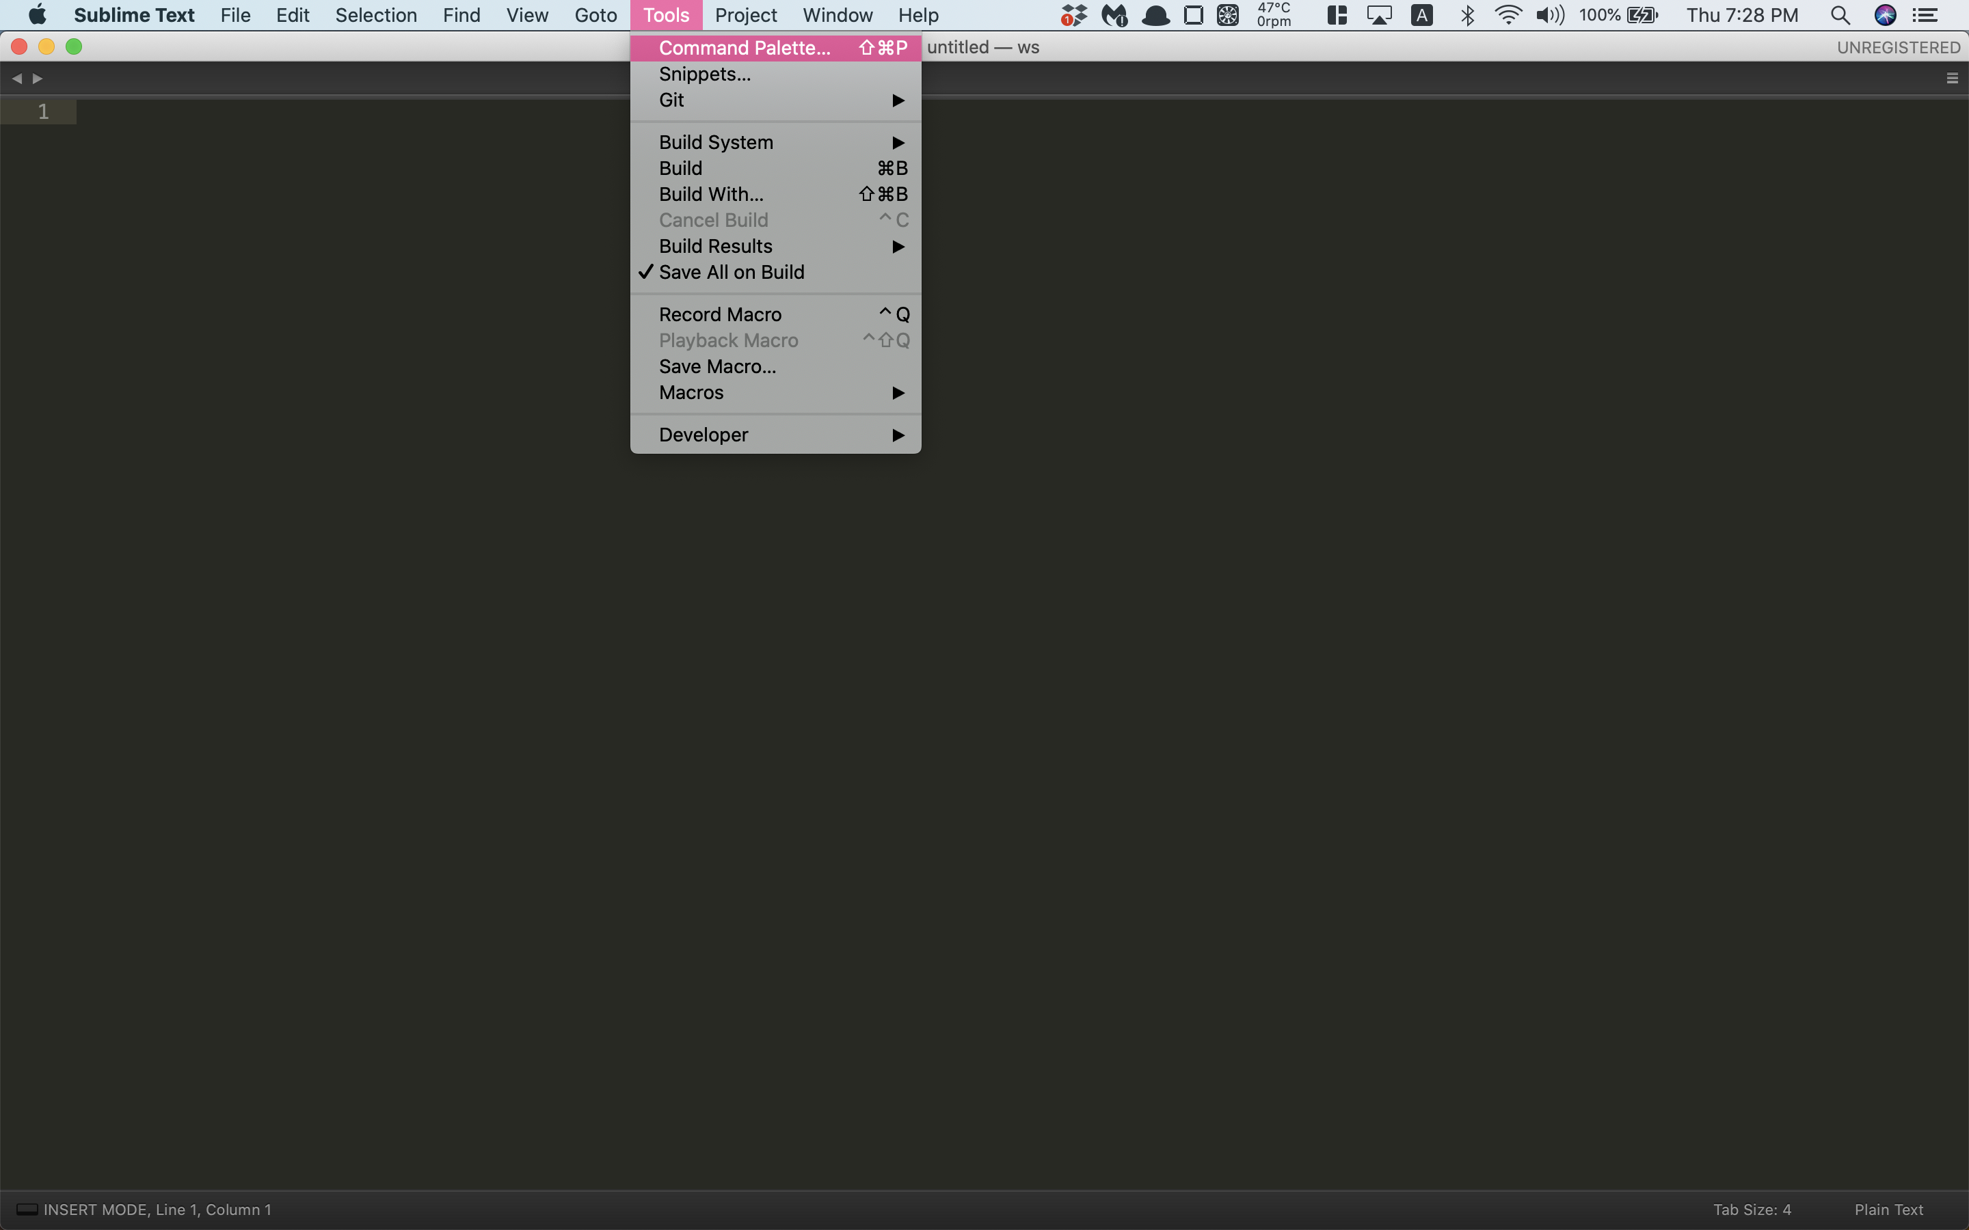
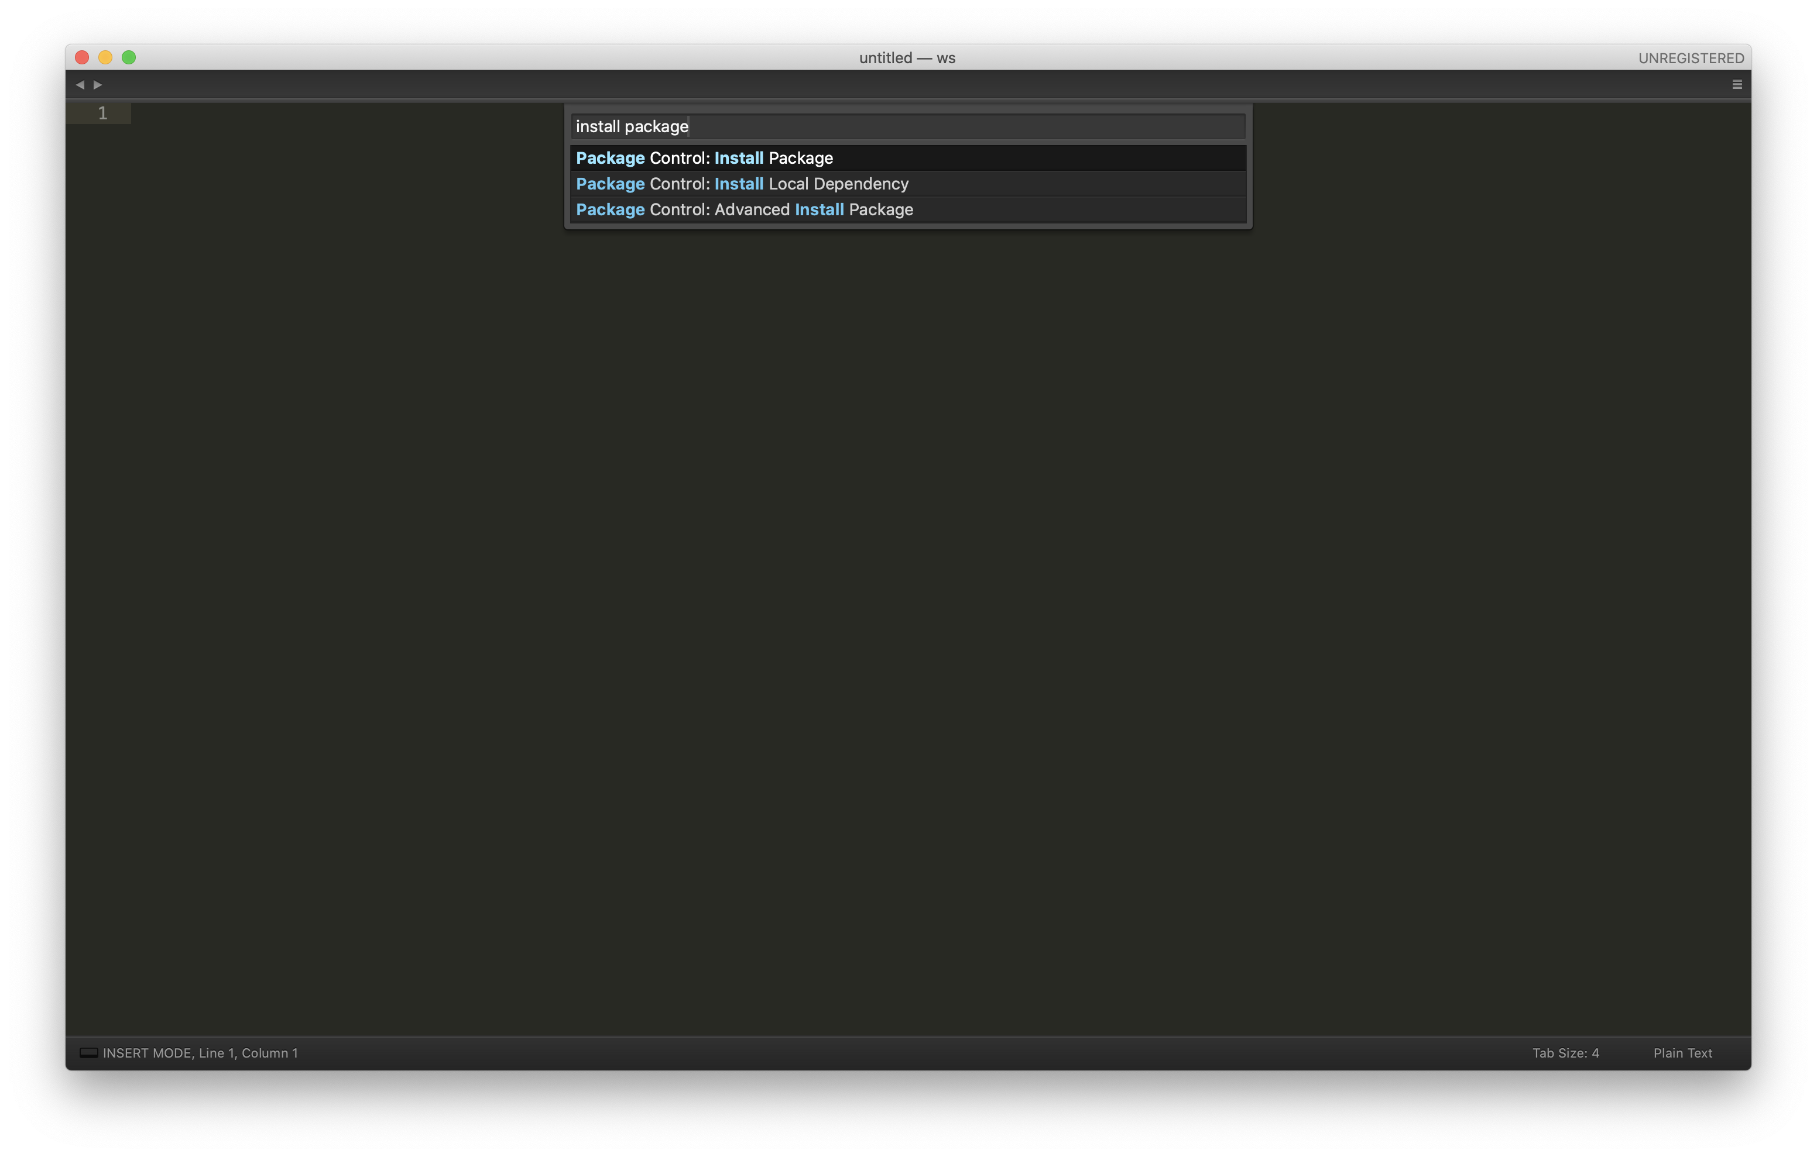
Install Packages
Go to Tools → Install Package Control…
Anaconda
PackageResourceViewer

Slide 18
Set PATH Environment Variable
Windows:
setx PATH "C:\change to your folder;%PATH%"
set PATH= C:\change to your folder;%PATH%
echo %PATH%
MacOS
nano ~/.bash_profile (if you use bash) or ~/.zshrc (if you use zsh), and then add:
export PATH="/Applications/QGIS.app/Contents/MacOS/bin:$PATH"

Slide 19
Install Python libraries
Check Python3 install path. Open Terminal and run
which python3
Install libraries using pip3
pip3 install descartes
pip3 install geopandas
pip3 install pysal
pip3 install jupyterlab
pip3 install watermark
pip3 install spreg

Slide 20
Quick Recap on Python
Data Types
Integers (e.g., -1, 0, 1, 2)
Float (e.g., -1.2, 1.5, 0.0)
Strings (e.g., “hello”)
Math Operators (+, -, *, /)
String Concatenation
Print(“hello” + “world”)
Functions
Define a Function
Pass Arguments
Data Structure
List
Tuple
Set
Dictionary
Notes:
a function is a block of coded instructions that perform a certain action. Once defined, a function can be reused throughout your program.

Slide 21
Quick Recap about Python
Create a List
Add Items to a List
Remove an Item from a List
Combine two Lists
Create a Nested List
Slice a List
Update Item Value
Loop Through the List
List Comprehensions
If not-in-List Statement
For Loop a List

Slide 22
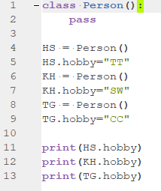
Class vs. Objects
Class acts as a blueprint for creating different objects.
Objects are an instance of a class. A class can be thought of as a template.
Notes:
What are Classes and Objects?
Python is an object-oriented programming language. Class acts as a blueprint for creating different objects. Objects are an instance of a class. A class can be thought of as a template. You cannot use it directly. To use it in a program, you must create an ‘instance’ of it.
Other OO concepts:
Compile-time Polymorphism
Run-time Polymorphism

Slide 23
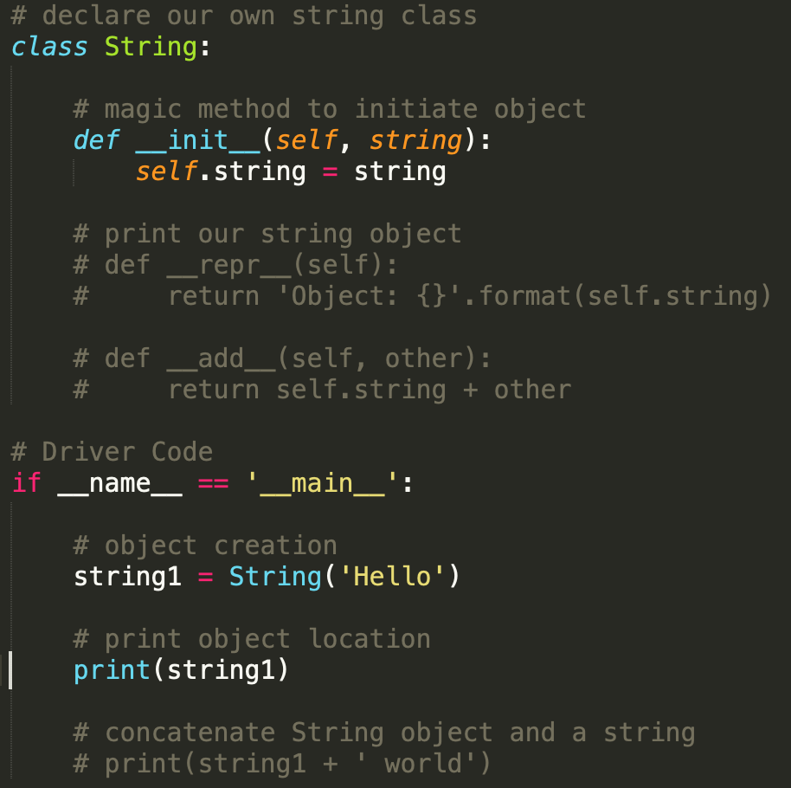
Dunder Methods in Python
Dunder methods are the methods having two prefix and suffix underscores in the method name.
These are commonly used for operator overloading.
Few examples for magic methods are: __init__, __add__, __len__, __repr__ etc.
Notes:
Dunder means “Double Under (Underscores)”.

Slide 24
🌏 Try Out Time ✋
Create a list with three string items (e.g., a, b, c)
Create a list with three integer items (e.g., 1, 2, 3)
Create a class MyClass with one function to loop print each item of the list.
Create a subclass MySubClass with one function called “sum_squared”. This function can
sum square the integer list (e.g., 1*1 + 2*2+3*3)
copy each string item (e.g., aa, bb, cc) and then join the list (e.g., aabbcc)

Slide 25
Strategy
Question ???
Prepare data

Slide 26
Qt, PyQt, PyQGIS
QGIS is built using the Qt platform, which is a free and open-source widget toolkit for creating GUI and cross-platform applications (written in C++).
Qt
PyQt
PyQt is the Python interface to Qt. PyQt provides classes and functions to interact with Qt widgets.
PyQGIS
PyQGIS are Python APIs provided by QGIS.
Notes:
Qt is a widget toolkit for creating graphical user interfaces as well as cross-platform applications that run on various software and hardware platforms such as Linux, Windows, macOS, Android or embedded systems with little or no change in the underlying codebase while still being a native application with native capabilities and speed.
Before we dive it to PyQGIS, it is important to understand certain concepts related to C++ and Python Classes. Qt as well as QGIS is written in C++ language. Functionality of each Qt/QGIS Widget is implemented as a class - having certain properties and functions. When we use PyQt or PyQGIS classes, it is executing the code in the C++ classes via the python bindings.
SIP is an open source software tool used to connect computer programs or libraries written in C or C++ with the scripting language Python. It is an alternative to SWIG. SIP was originally developed in 1998 for PyQt

Slide 27
PyQt Example
Example in QGIS
mb = QMessageBox()
Tell class of an Object:
type(mb)
The attributes and methods of any object
dir(mb)
QObject
QWidget
QDialog
QMessageBox

Slide 28
Organization of QGIS Libraries
core library | The CORE library contains all basic GIS functionality
gui library | The GUI library is build on top of the CORE library and adds reusable GUI widgets
analysis library | The ANALYSIS library is built on top of CORE library and provides high level tools for carrying out spatial analysis on vector and raster data
server library | The SERVER library is built on top of the CORE library and adds map server components to QGIS
3D library | The 3D library is build on top of the CORE library and Qt 3D framework
plugin classes | Contains classes related to implementation of QGIS plugins
QgsQuick library | The QgsQuick library is built on top of the CORE library and Qt Quick/QML framework
Notes:
This is the QGIS C++ API.

Slide 29
Organization of PyQGIS API
qgis.core | The CORE library contains all basic GIS functionality
qgis.gui | The GUI library is build on top of the CORE library and adds reusable GUI widgets
qgis.processing | The processing library contains classes for processing toolbox
qgis.analysis | The ANALYSIS library is built on top of CORE library and provides high level tools for carrying out spatial analysis on vector and raster data
qgis.server | The SERVER library is built on top of the CORE library and adds map server components to QGIS
qgis.3d | The 3D library is build on top of the CORE library and Qt 3D framework
Notes:
let’s see how the PyQGIS libraries are structured. All of the PyQGIS libraries are organized under a package named qgis. You wouldn’t normally import qgis directly, however, as all the interesting libraries are subpackages within this main package; here are the five packages that make up the PyQGIS library:
qgis.core, qgis.gui, and qgis.processing implement the most important parts of the PyQGIS library, and it’s worth spending some time to become more familiar with the concepts and classes they define. Now let’s take a closer look at these three packages.

Slide 30
qgis.gui.QgsProject
QgisInterface
A reference to QgisInterface is typically available through the iface global variable.
Get a reference to the map canvas displayed within the main application window, using the mapCanvas() method.
Retrieve the currently active layer within the project, using the activeLayer() method.
Get a reference to the application’s main window by calling the mainWindow() method.
Get a reference to the QGIS system’s message bar by calling the messageBar() method.
Notes:
The qgis.gui package defines a number of user-interface widgets that you can include in your programs. Let’s start by looking at the most important qgis.gui classes.
When running Python code within a script or a plugin, or directly from the QGIS Python console,
Note that, The QgisInterface object is only available when running the QGIS application itself. If you are running an external application and import the PyQGIS library into your application, QgisInterface won’t be available.

Slide 31
qgis.core.QgsProject
QgsProject
QgsMapLayer1
QgsMapLayer2
…
QgsMapLayerN
QgsGeometry
Notes:
QgsProject is a singleton class, so you must use its instance().

Slide 32
qgis.core.QgsProject example
import os
# change your current work directory
os.chdir("/Users/hs/Projects/pyqgis")
# as QgsProject is Singleton class, we need to get the instance of it
project = QgsProject.instance()
# open the project
project_name = 'Data/QgsProject.qgs'
project.read(project_name)
QgsGeometry
Notes:
QgsProject is a singleton class, so you must use its instance().

Slide 33
qgis.core.QgsMapLayer example
# list of layer names using list comprehension
layers = project.mapLayers()
l=[layer.name() for layer in layers.values()]
# dictionary with key = layer name and value = layer object
layers_list = {}
for l in layers.values():
layers_list[l.name()] = l
print(layers_list)
QgsGeometry
Notes:
QgsProject is a singleton class, so you must use its instance().

Slide 34
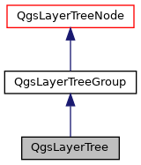
qgis.core.QgsLayerTree example
root = QgsProject.instance().layerTreeRoot()
# create two tree groups
group1 = root.addGroup("group1")
# get a QgsVectorLayer
vl1 = QgsProject.instance().mapLayersByName("MP14_Subzone_Central")[0]
# create a QgsLayerTreeLayer object from vl by its id
myvl1 = root.findLayer(vl1.id())
# clone the myvl QgsLayerTreeLayer object
myvl1clone = myvl1.clone()
# get the parent. If None (layer is not in group) returns ‘ '
parent = myvl1.parent()
# move the cloned layer to the top (0)
group1.insertChildNode(0, myvl1clone)
# remove the QgsLayerTreeLayer from its parent
parent.removeChildNode(myvl1)
Notes:
The layer tree is a classical tree structure built of nodes.
There are currently two types of nodes: group nodes (QgsLayerTreeGroup) and layer nodes (QgsLayerTreeLayer).

Slide 35
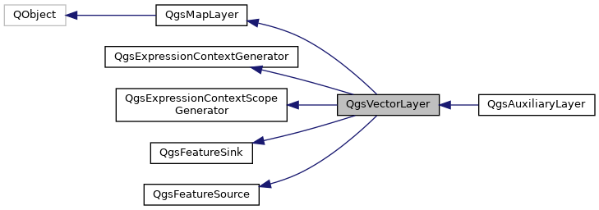
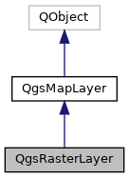
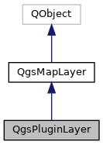
qgis.core.QgsVectorLayer

Slide 36
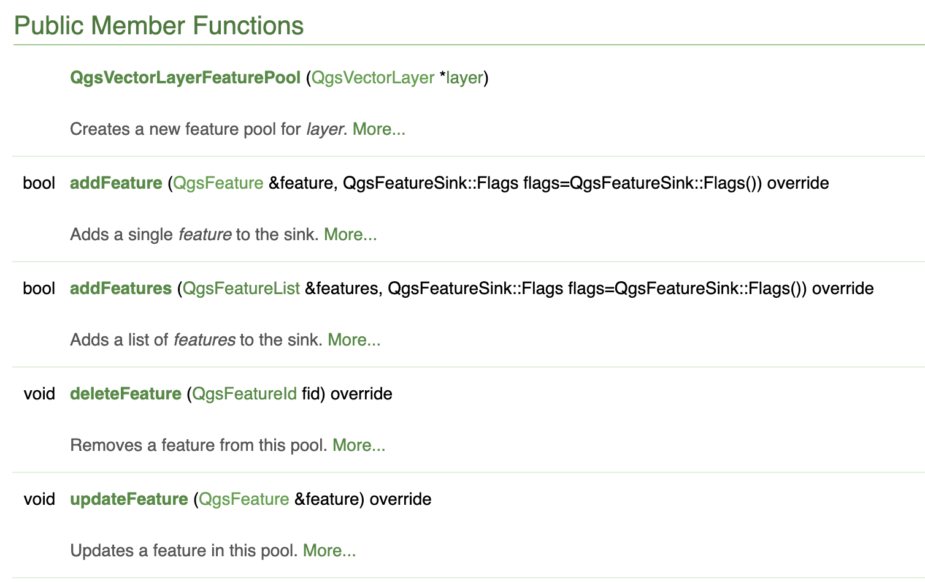
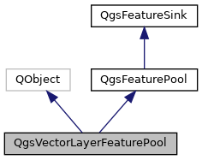
qgis.core. QgsVectorLayer
Notes:
An interface for objects which accept features via addFeature(s) methods.

Slide 37
qgis.core. QgsVectorLayer
QgsFeatureSink
QgsVectorLayer
QgsFeature 1
QgsFeature 2
…
QgsFeature n

Slide 38
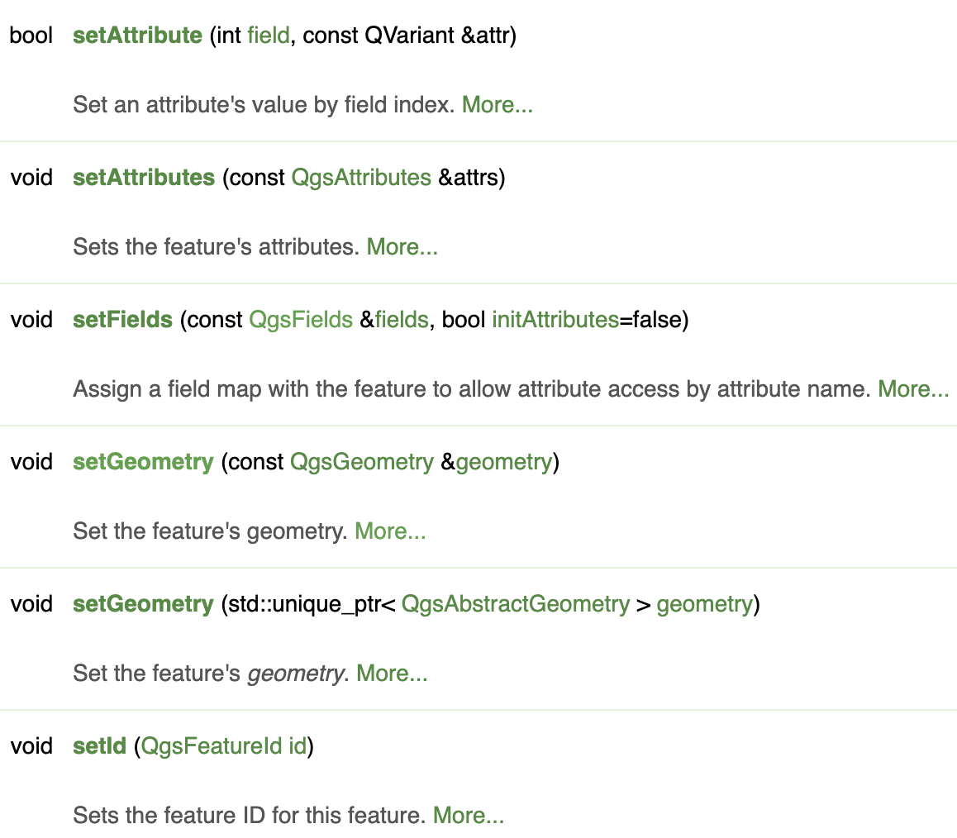
qgis.core.QgsFeature
The QgsFeature encapsulates a single feature including its id, geometry and a list of field/values attributes.

Slide 39
qgis.core.QgsFeature example
# use QgsInterface global variable iface to get active layer
layer = iface.activeLayer()
features = layer.getFeatures()
for feature in features:
# retrieve every feature with its geometry and attributes
print("Feature ID: ", feature.id())
# fetch attributes
attrs = feature.attributes()
# attrs is a list. It contains all the attribute values of this feature
print(attrs)
Notes:
QgsProject is a singleton class, so you must use its instance().

Slide 40
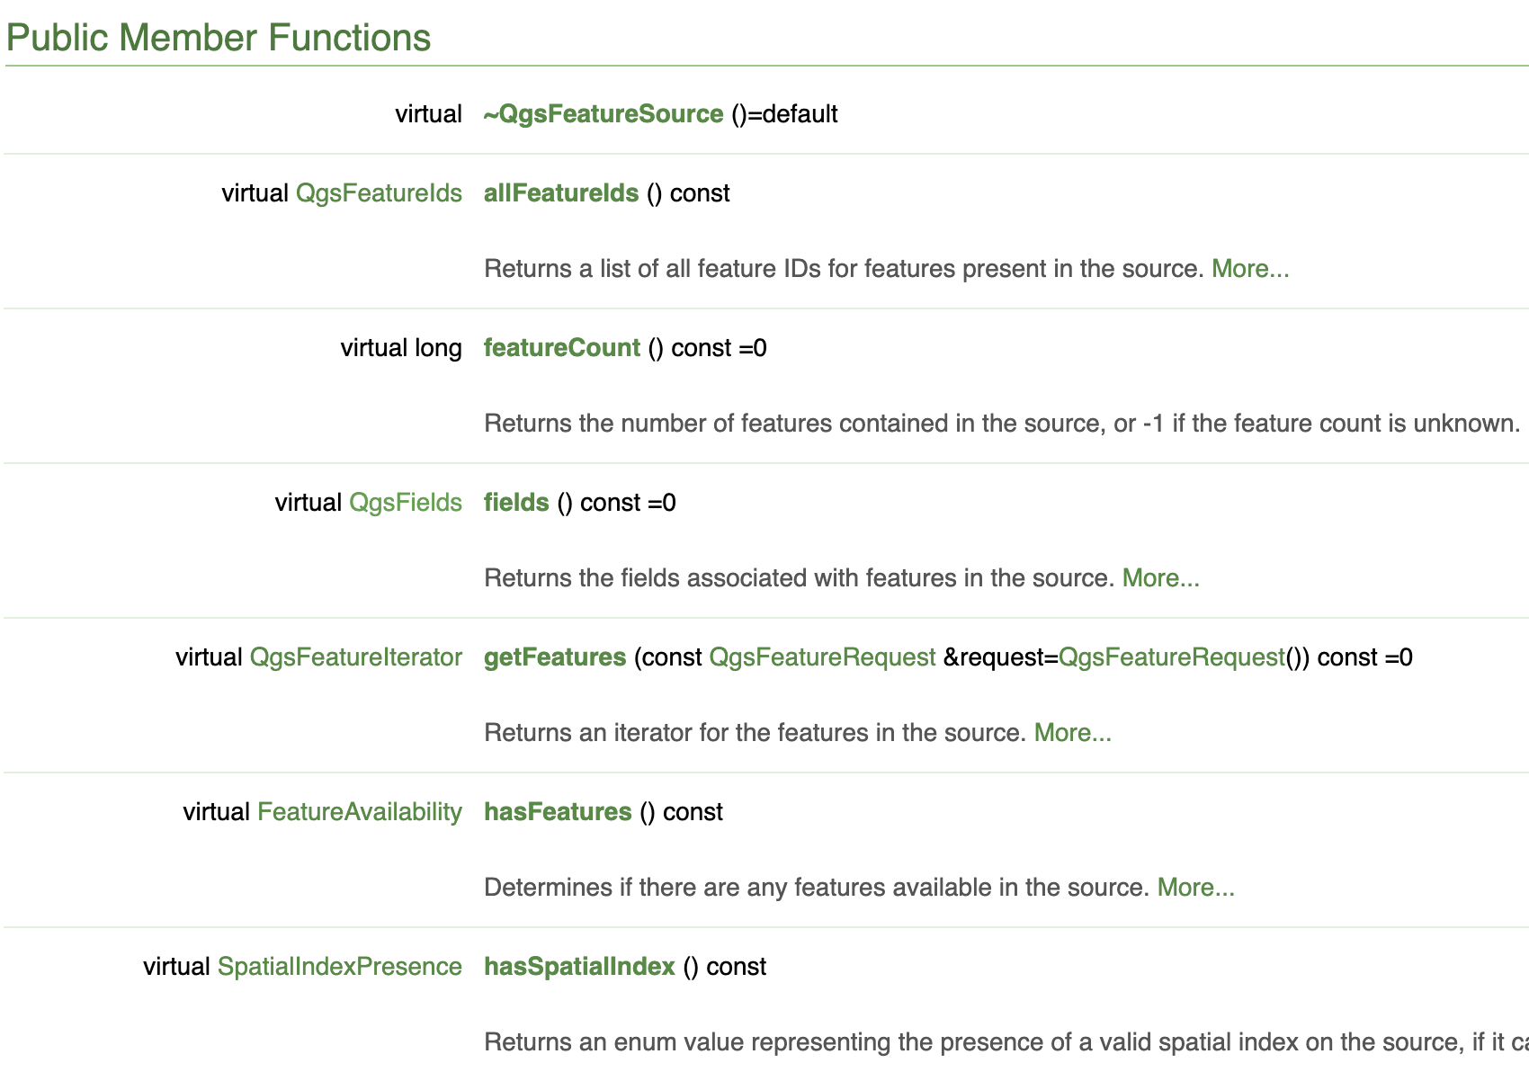
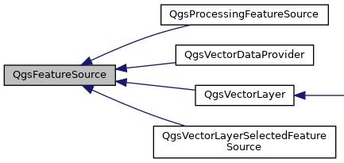
qgis.core.QgsFeatureSource

Slide 41
qgis.core.QgsFields
QgsFeatureSource
QgsVectorLayer
QgsFields
QgsField 1
QgsField 2
…
QgsField N

Slide 42
qgis.core.QgsFields example
layer = iface.activeLayer()
output_name = 'Data_Day1/output.csv'
# Using*with* statement which takes care of closing the files and handling errors
with open(output_name, 'w') as output_file:
fieldnames = [field.name() for field in layer.fields()]
## write header
line = ','.join(name for name in fieldnames) + '\n'
output_file.write(line)
# write feature attributes
for f in layer.getFeatures():
line = ','.join(str(f[name]) for name in fieldnames) + '\n'
output_file.write(line)
iface.messageBar().pushMessage(
'Success:', 'Output file written at ' + output_name, level=Qgis.Success)
Notes:
QgsProject is a singleton class, so you must use its instance().

Slide 43
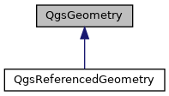
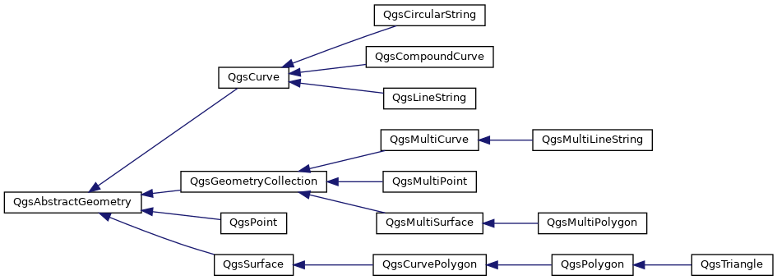
qgis.core.QgsGeometry
Notes:
QgsGeometry acts as a generic container for geometry objects. QgsGeometry objects are implicitly shared, so making copies of geometries is inexpensive.
The actual geometry representation is stored as a QgsAbstractGeometry within the container, and can be accessed via the get() method or set using the set() method. This gives access to the underlying raw geometry primitive, such as the point, line, polygon, curve or other geometry subclasses.

Slide 44
qgis.core.QgsGeometry example
geom = feature.geometry()
geomSingleType = QgsWkbTypes.isSingleType(geom.wkbType())
if geom.type() == QgsWkbTypes.PointGeometry:
# the geometry type can be of single or multi type
if geomSingleType:
x = geom.asPoint()
print("Point: ", x)
else:
x = geom.asMultiPoint()
print("MultiPoint: ", x)
elif geom.type() == QgsWkbTypes.LineGeometry:
# the geometry type can be of single or multi type
if geomSingleType:
x = geom.asPolyline()
print("Line: ", x, "length: ", geom.length())
else:
x = geom.asMultiPolyline()
print("MultiLine: ", x, "length: ", geom.length())
elif geom.type() == QgsWkbTypes.PolygonGeometry:
# the geometry type can be of single or multi type
if geomSingleType:
x = geom.asPolygon()
print("Polygon: ", x, "Area: ", geom.area())
else:
x = geom.asMultiPolygon()
print("MultiPolygon: ", x, "Area: ", geom.area())
else:
print("Unknown or invalid geometry")
Notes:
QgsProject is a singleton class, so you must use its instance().

Slide 45
Modify a Vector Layer Example
# add new field
layer.dataProvider().addAttributes([QgsField("STATUT", QVariant.Int)])
layer.updateFields()
# remove a field
fieldIndex = layer.fields().indexFromName("STATUT")
layer.dataProvider().deleteAttributes([fieldIndex])
layer.updateFields()
feat1 = feat2 = QgsFeature(layer.fields())
fid = 99
feat1.setId(fid)
# add two features (QgsFeature instances)
layer.addFeatures([feat1,feat2])
# delete a feature with specified ID
layer.deleteFeature(fid)
# set new geometry (QgsGeometry instance) for a feature
geometry = QgsGeometry.fromWkt("POINT(7 45)")
layer.changeGeometry(fid, geometry)
# update an attribute with given field index (int) to a given value
fieldIndex =1
value ='My new name'
layer.changeAttributeValue(fid, fieldIndex, value)
Notes:
QgsProject is a singleton class, so you must use its instance().

Slide 46
Geometry Construction
# Construct Geometry from coordinates
gPnt = QgsGeometry.fromPointXY(QgsPointXY(1,1))
print(gPnt)
gLine = QgsGeometry.fromPolyline([QgsPoint(1, 1), QgsPoint(2, 2)])
print(gLine)
gPolygon = QgsGeometry.fromPolygonXY([[QgsPointXY(1, 1),
QgsPointXY(2, 2), QgsPointXY(2, 1)]])
print(gPolygon)
# Construct Geometry from well known text
geom = QgsGeometry.fromWkt("POINT(3 4)")
print(geom)

Slide 47
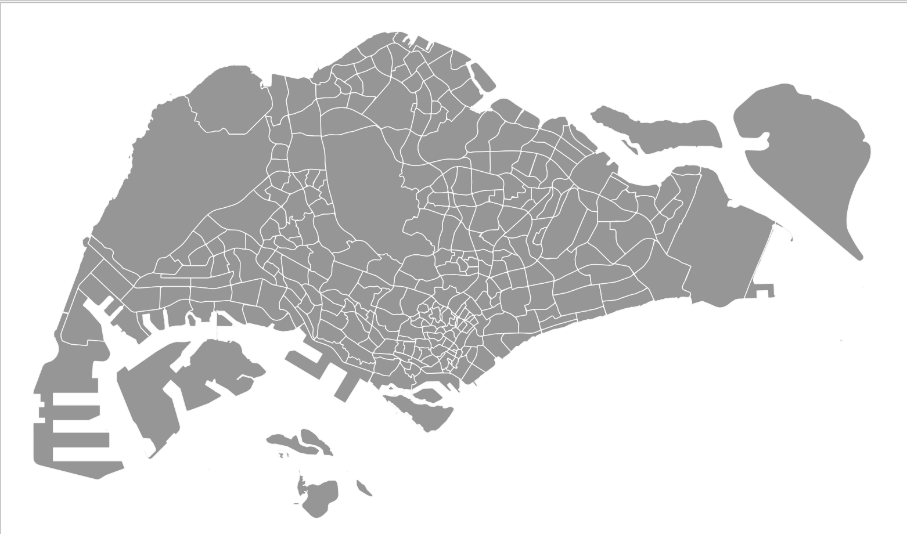
Exploring Data using PyQGIS
🌏 Try Out Time ✋
Open QGIS Project Data/QgsProject.qgs
Find the layer MP14 Subzone SocioEconIndicators_2017
Iterate all features of this layer and export all attributes into a csv file.
Iterate all geometry of this layer and export centroid coordinates (X, Y) into a csv file.

Slide 48
qgis.core.QgsDistanceArea
QgsGeometry objects are inherently Cartesian/planar geometries. They have no concept of geodesy, and none of the methods or properties exposed from the QgsGeometry API (or QgsAbstractGeometry subclasses) utilize geodesic calculations.
In contrast, the QgsDistanceArea class exposes methods for working with geodesic calculations and spatial operations on geometries, and should be used whenever calculations which account for the curvature of the Earth (or any other celestial body) are required.
Notes:
QgsGeometry, properties like length() and area() or spatial operations like buffer() are always calculated using strictly Cartesian mathematics.

Slide 49
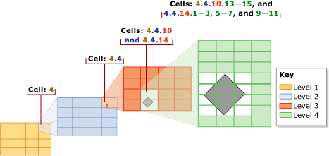
Spatial Index
A spatial index is a type of extended index that allows you to index a spatial column (geometry). The B-tree generalizes the binary search tree, allowing for nodes with more than two children. B-tree implements a hierarchical uniform decomposition of space.
Notes:
Spatial indexes can dramatically improve the performance of your code if you need to do frequent queries to a vector layer.
Think of a layer without a spatial index as a telephone book in which telephone numbers are not ordered or indexed. The only way to find the telephone number of a given person is to read from the beginning until you find it.
B-tree: On a given level, all the grids have the same number of cells along both axes (for example, 4x4 or 8x8), and the cells are all one size.

Slide 50
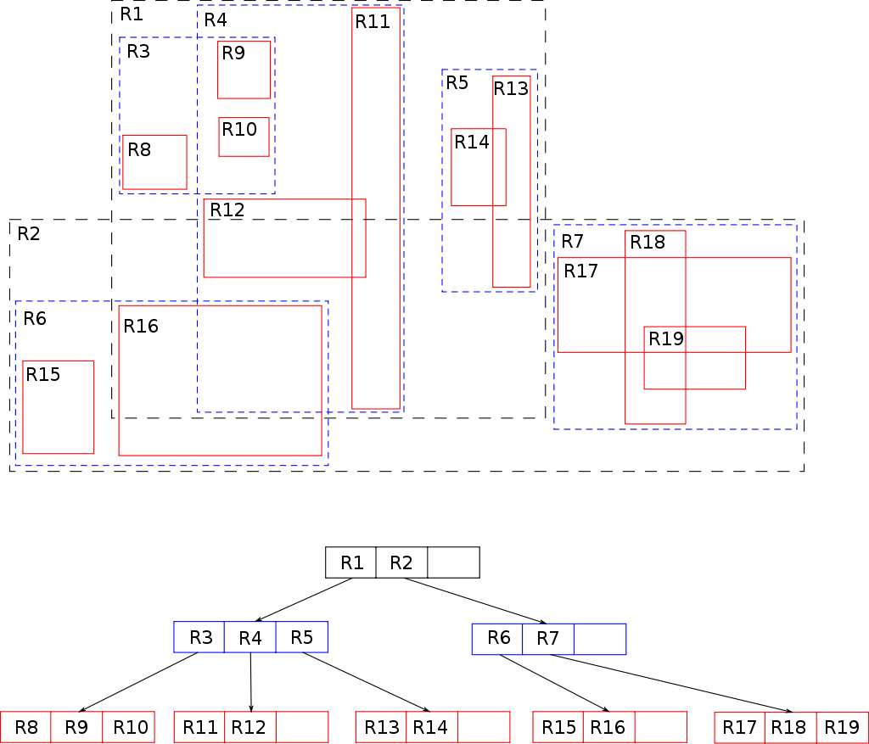
Spatial Index
R-tree groups nearby objects and represent them with their minimum bounding rectangle in the next higher level of the tree.
Notes:
The "R" in R-tree is for rectangle. Similar to the B-tree, the R-tree is also a balanced search tree (so all leaf nodes are at the same depth),
When data is organized in an R-tree, the neighbors within a given distance r and the k nearest neighbors of all points can efficiently be computed using a spatial join.

Slide 51
Modify a Vector Layer Example
# use QgsInterface global variable iface to get active layer
layer = iface.activeLayer()
index = QgsSpatialIndex(layer.getFeatures())
# returns array of feature IDs of five nearest features
nearest = index.nearestNeighbor(QgsPointXY(27404, 28986), 5)
# returns array of IDs of features which intersect the rectangle
intersect = index.intersects(QgsRectangle(27189, 29180, 27878, 28642))
Notes:
QgsProject is a singleton class, so you must use its instance().

Slide 52
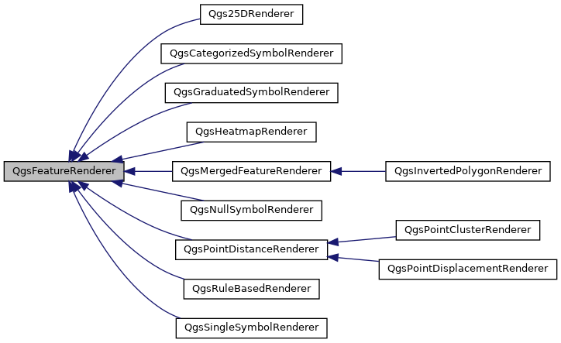
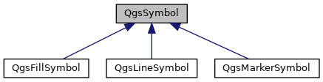
qgis.core - Display Vector Data
Renders features using a different symbol
for each category
Renders features using a different symbol
for each range of values
The renderer chooses the symbol to use for a given feature.
The symbol that does the actual drawing.
Renders all features with the same symbol
Notes:
The features within a vector map layer are displayed using a combination of renderer and symbol objects.
Internally, symbols are rather complex, as “symbol layers” allow multiple elements to be drawn on top of each other. In most cases, however, you can make use of the “simple” version of the symbol. This makes it easier to create a new symbol without having to deal with the internal complexity of symbol layers.
symbol = QgsMarkerSymbolV2.createSimple({'width' : 1.0, 'color' : "255,0,0"})
While symbols draw the features onto the map, a renderer is used to choose which symbol to use to draw a particular feature. In the simplest case, the same symbol is used for every feature within a layer. This is called a single symbol renderer, and is represented by the qgis.core.QgsSingleSymbolRender class
Categorized symbol renderer (qgis.core.QgsCategorizedSymbolRendererV2): This renderer chooses a symbol based on the value of an attribute. The categorized symbol renderer has a mapping from attribute values to symbols.
Graduated symbol renderer (qgis.core.QgsGraduatedSymbolRendererV2): This type of renderer has a range of attribute, values, and maps each range to an appropriate symbol.

Slide 53
Display Vector Data Example
# create a simple symbol with red square
symbol = QgsMarkerSymbol.createSimple({'name': 'x', 'color': 'red'})
layer.renderer().setSymbol(symbol)
# show the change
layer.triggerRepaint()
Notes:
QgsProject is a singleton class, so you must use its instance().

Slide 54
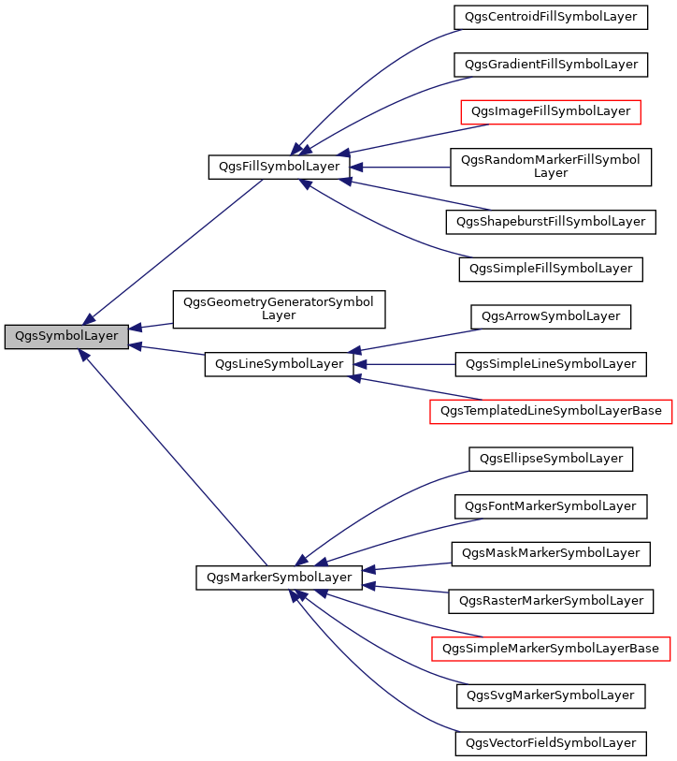
qgis.core - Display Vector Data
Symbol layers are the building blocks that make up a representation rule.
Symbol layers are categorized by symbol type—fill, line, or marker—to symbolize polygon, line, and point features, respectively.
Notes:
Every symbol consists of one or more symbol layers (classes derived from QgsSymbolLayer). The symbol layers do the actual rendering, the symbol class itself serves only as a container for the symbol layers.
Marker symbol layers are unique in that, along with defining the appearance of a point feature or location with a representation marker, you must also choose and define a marker placement style.
There are several basic symbol layer classes for general use. It is possible to implement new symbol layer types and thus arbitrarily customize how features will be rendered.

Slide 55
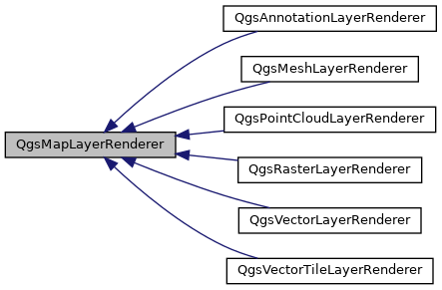
qgis.core - Display Vector Data

Slide 56
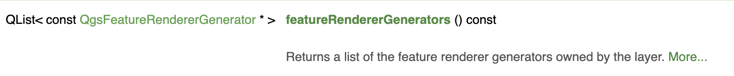
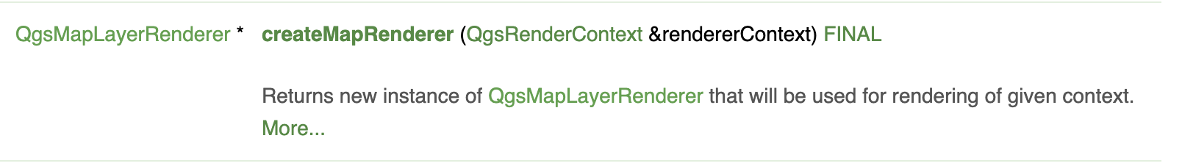
QgsVectorLayer
QgsFeatureRendererGenerator
QgsFeatureRenderer
QgsVectorLayer
QgsVectorLayerRenderer

Slide 57
Map Canvas
The Map canvas widget shows the map and allows interaction with the map and layers.
QGraphicsView1
QGraphicsViewN
QGraphicsView visualizes
the contents of a scene.
QGraphicsScene
QGraphicsScene serves as a container for QGraphicsItem objects.
QGraphicsItem1
QGraphicsItem2
…
QGraphicsItemN
QGraphicsItems are typical shapes such as
rectangles, ellipses and text items.
QgsMapCanvasItem
Qt Graphics View Framework
Notes:
You can attach several views to the same scene, to provide several viewports into the same data set. The view receives input events from the keyboard and mouse, and translates these to scene events, before sending the events to the visualized scene.
Whenever the map has been panned, zoomed in/out, the map is rendered again within the current extent. The layers are rendered to an image and that image is displayed on the canvas.

Slide 58
Map Canvas
The Map canvas widget shows the map and allows interaction with the map and layers.
map canvas — for viewing of the map
map canvas items — additional items that can be displayed on the map canvas
map tools — for interaction with the map canvas
Notes:
You can attach several views to the same scene, to provide several viewports into the same data set. The view receives input events from the keyboard and mouse, and translates these to scene events, before sending the events to the visualized scene.
Whenever the map has been panned, zoomed in/out, the map is rendered again within the current extent. The layers are rendered to an image and that image is displayed on the canvas.

Slide 59
Expressions, Filtering and Calculating Values
arithmetic operators: +, -, *, /, ^
mathematical functions: sqrt, sin, cos, tan, asin, acos, atan
conversion functions: to_int, to_real, to_string, to_date
geometry functions: $area, $length
geometry handling functions: $x, $y, $geometry, num_geometries, centroid
comparison: =, !=, >, >=, <, <=
pattern matching: LIKE (using % and _), ~ (regular expressions)
logical predicates: AND, OR, NOT
NULL value checking: IS NULL, IS NOT NULL

Slide 60
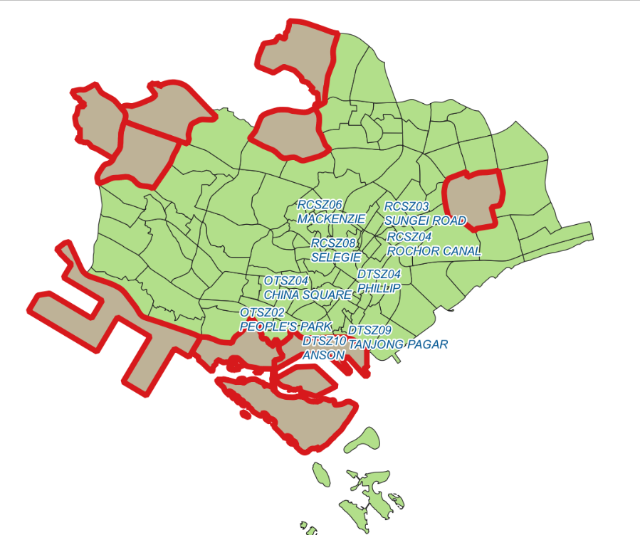
Exploring Data using PyQGIS
🌏 Try Out Time ✋

Slide 61
Quick Recap about Day 1
Intro to PyQGIS APIs
Write Python Scripts to
Load spatial data
Spatial query
Spatial Join
Stylizing & labelling
Day 2
Intro to Python packages
Basic concepts:
Spatial Auto-correlation
Spatial Weights
Spatial Regression using PySAL

Slide 62
Python Libraries
Numpy: Operations related to linear algebra
Pandas & GeoPandas: data (geospatial) manipulation and analysis
Matplotlib & Seaborn: making plots
Scikit-learn: general-purpose machine learning
Notes:
NumPy is a Python package. It stands for 'Numerical Python'. It is a library consisting of multidimensional array objects and a collection of routines for processing of array.
Mathematical and logical operations on arrays.
Fourier transforms and routines for shape manipulation.
Operations related to linear algebra. NumPy has in-built functions for linear algebra and random number generation.
Pandas is a core scientific Python library to work with “Panel Data” (PanDas). Basically if you have a spreadsheet or database you should be using Pandas. Pandas has many input/output (I/O) functions, and two core data structures - the “Series” and “DataFrame”.
Geopandas extends Pandas to work efficently with collections of geographic Vector data - geometric shapes that are georeferenced to a position on Earth’s surface. Geopandas data objects are, you might have guessed, called “GeoSeries” and “GeoDataFrame”.

Slide 63
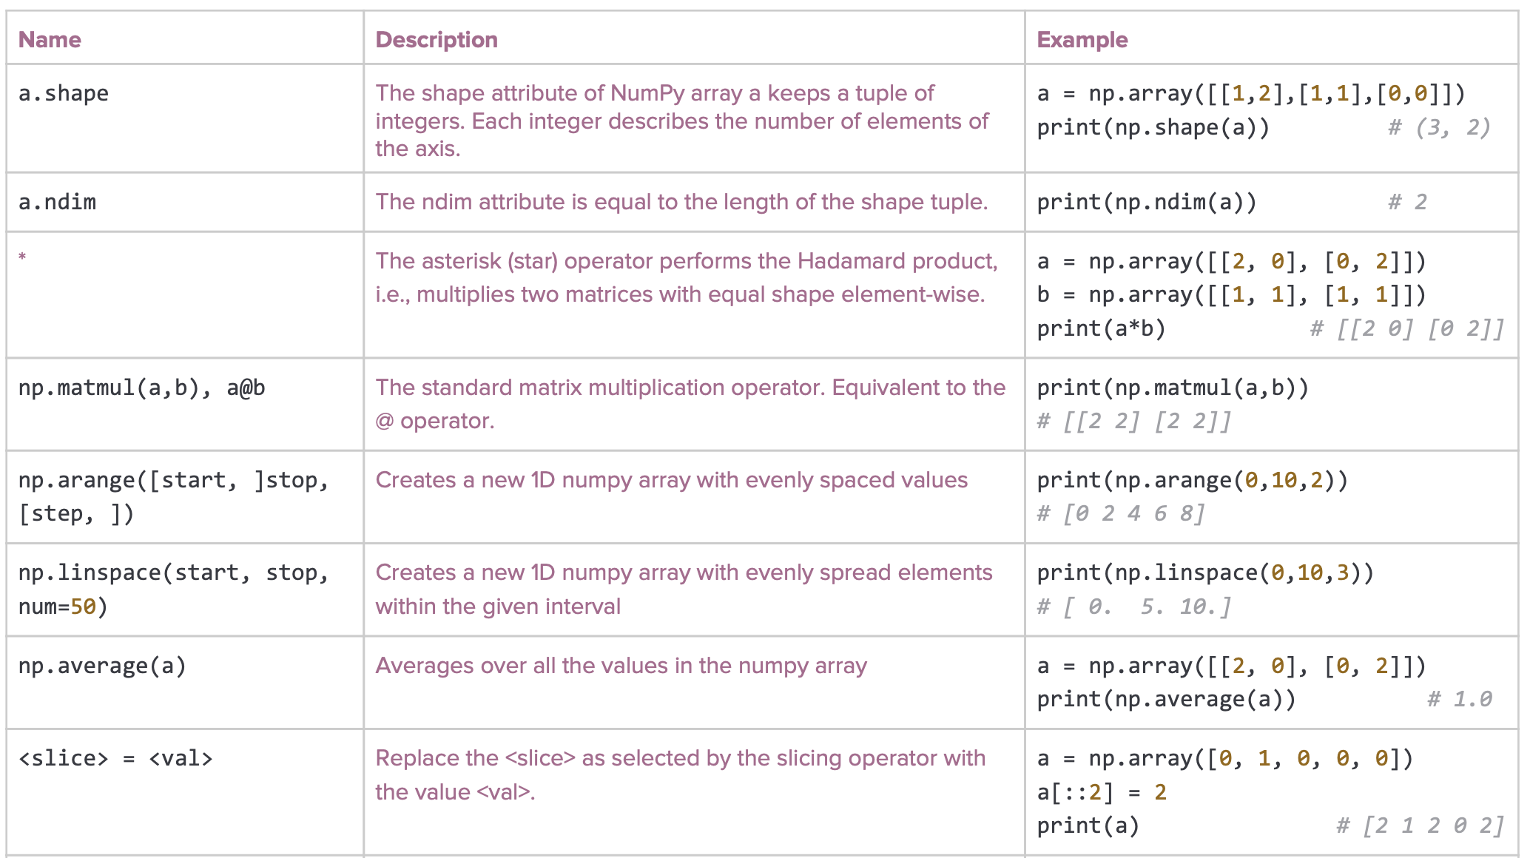

Slide 64
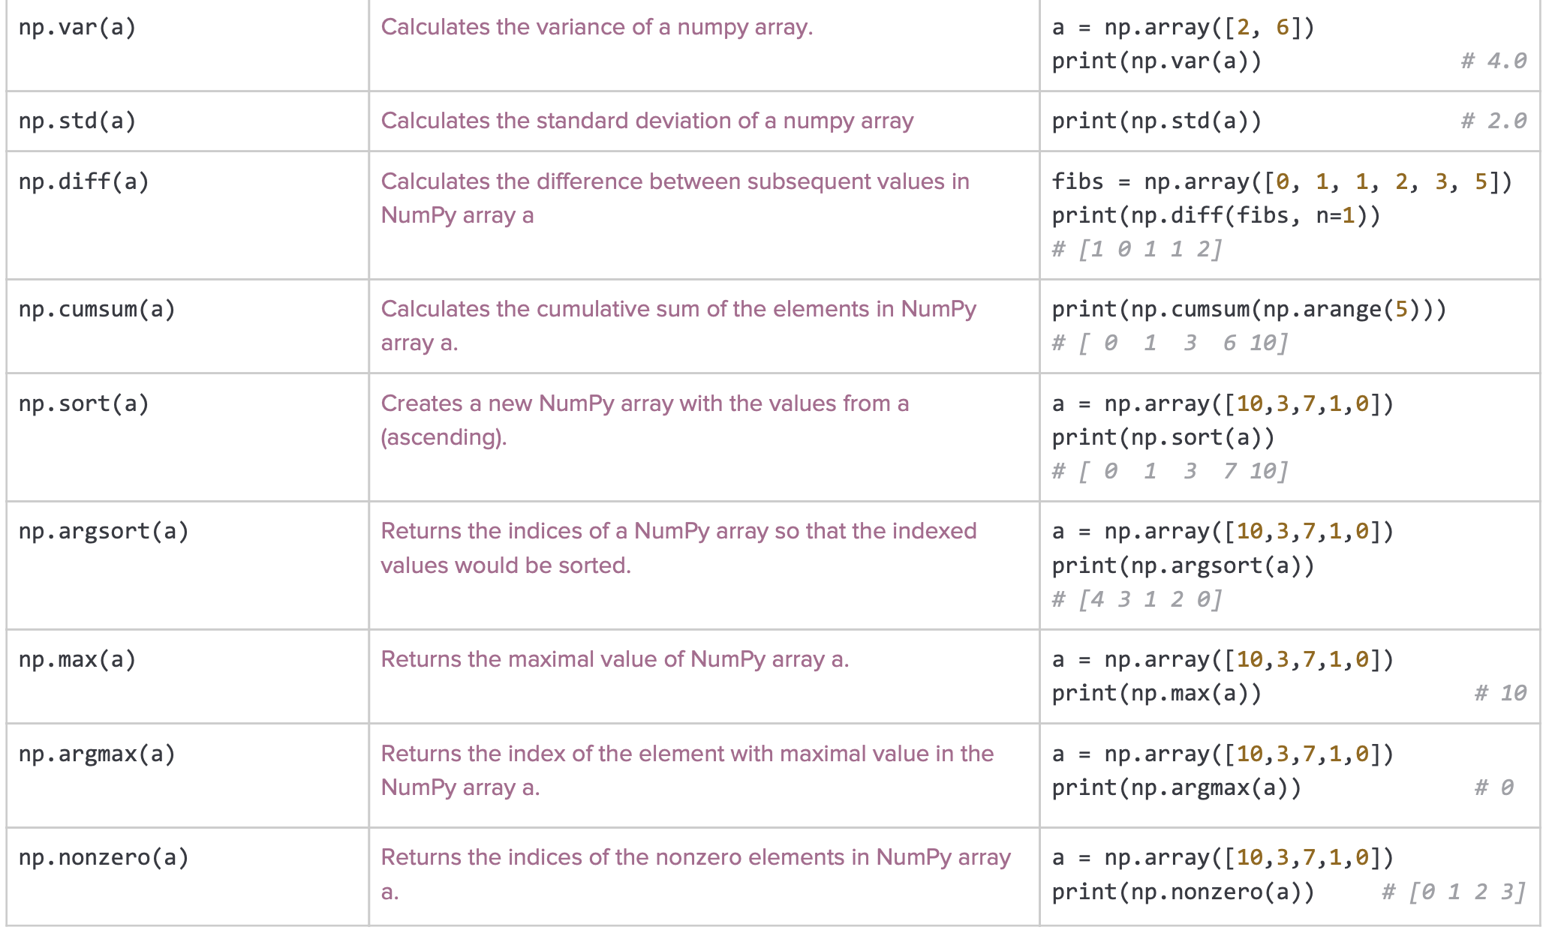

Slide 67
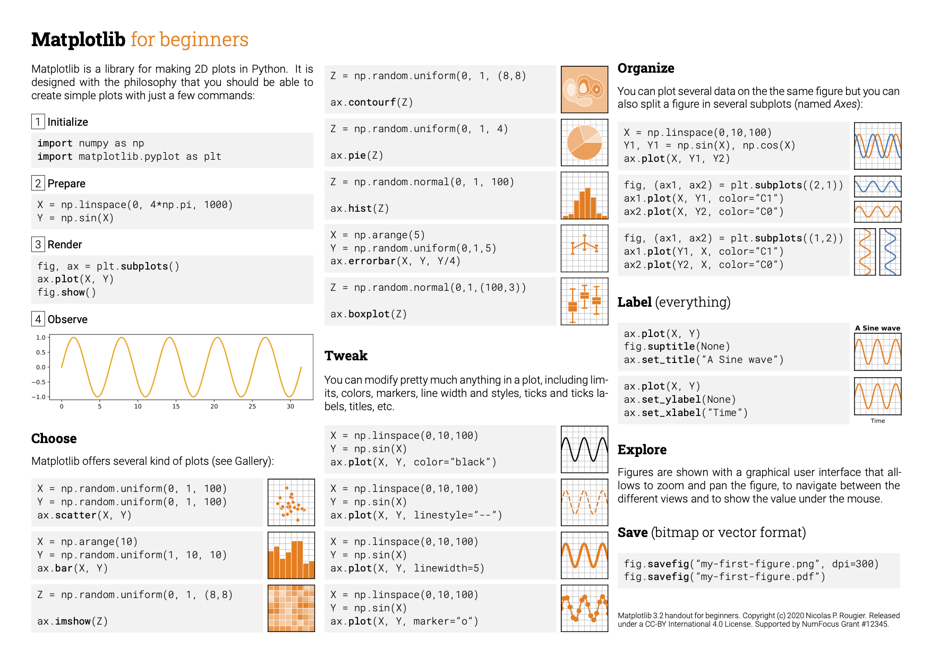

Slide 68
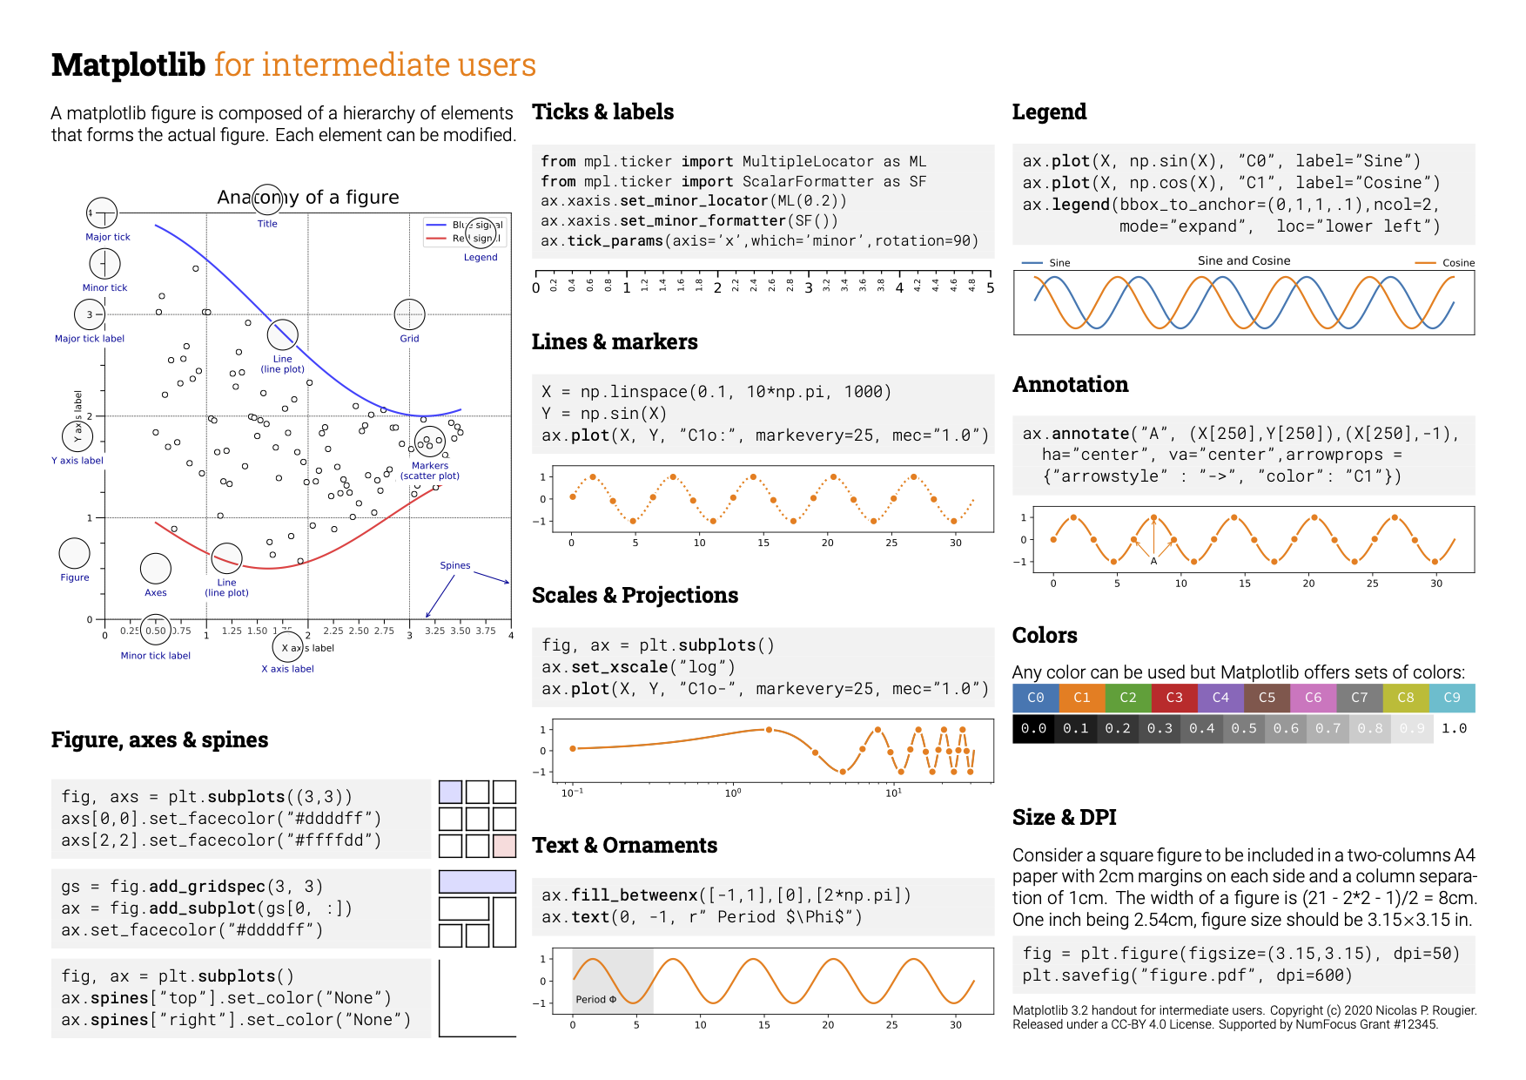
Notes:
A Figure object is the outermost container for a matplotlib graphic, which can contain multiple Axes objects. One source of confusion is the name: an Axes actually translates into what we think of as an individual plot or graph (rather than the plural of “axis,” as we might expect).
You can think of the Figure object as a box-like container holding one or more Axes (actual plots). Below the Axes in the hierarchy are smaller objects such as tick marks, individual lines, legends, and text boxes. Almost every “element” of a chart is its own manipulable Python object, all the way down to the ticks and labels:
Above, fig (a Figure class instance) has multiple Axes (a list, for which we take the first element). Each Axes has a yaxis and xaxis, each of which have a collection of “major ticks,” and we grab the first one.
[With pyplot], simple functions are used to add plot elements (lines, images, text, etc.) to the current axes in the current figure.”
plt.plot() is a state-machine interface that implicitly tracks the current figure!

Slide 69
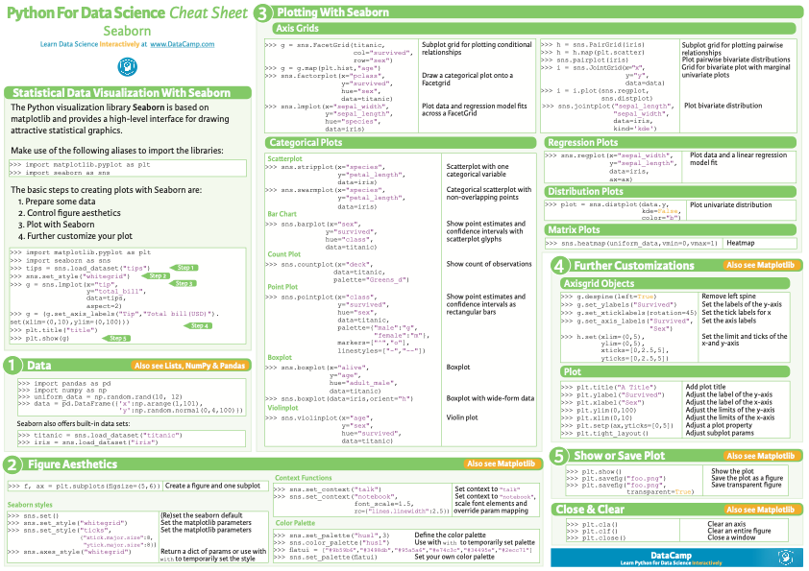

Slide 70


Slide 71
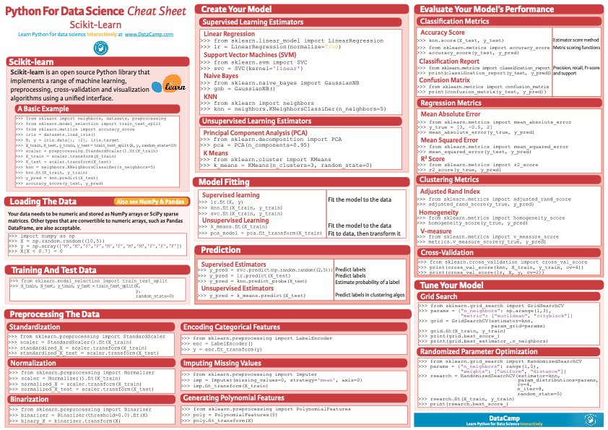

Slide 72
Linear Regression Model
y
Coefficient (slope)
Residuals
R-squared (variance explained)
x
Notes:
linear regression is a linear approach to modelling the relationship between a scalar response and one or more explanatory variables (also known as dependent and independent variables).
This relationship is modeled through a disturbance term or error variable ε — an unobserved random variable that adds "noise" to the linear relationship between the dependent variable and regressors.
Ordinary Least Squares (OLS) is the most common estimation method for linear models. Our goal is to draw a random sample from a population and use it to estimate the properties of that population.
When your linear regression model satisfies the OLS assumptions, the procedure generates unbiased coefficient estimates that tend to be relatively close to the true population values (minimum variance).
R squared:
variance is a measure of how far observed values differ from the average of predicted values

Slide 73
OLS Assumptions:
The regression model is linear in the coefficients and the error term.
The error term has a population mean of zero.
All independent variables are uncorrelated with the error term.
Observations of the error term are uncorrelated with each other
The error term has a constant variance (no heteroscedasticity)
No independent variable is a perfect linear function of other explanatory variables (avoid multicollinearity)
The error term is normally distributed (optional)
Notes:
Linear models can model curvature by including nonlinear variables such as polynomials and transforming exponential functions.
Suppose the average error is +7. This non-zero average error indicates that our model systematically underpredicts the observed values. If the expected value is +7 rather than zero, part of the error term is predictable, and we should add that information to the regression model itself. We want only random error left for the error term.

Slide 74
Linear Regression Models
Ordinary Least Squares (OLS)
Spatial Auto-Regression
Geographically Weighted Regression (GWR)
Notes:
There are mainly three kinds of regression models: Ordinary Least Squares (OLS) which ignores any spatial effect, Spatial AutoRegression (SAR) and Geographically Weighted Regression (GWR) which take into consideration the spatial effect.
OLS is based on certain assumptions, among them the independence of residuals. So before applying OLS for prediction we should check if residuals are independent or not using either graphical tools or statistical tests (for example Moran's I) and for spatial stationarity (for example Breusch-Pagan test).
If the independence of residuals and spatial stationarity are accepted then OLS can be used confidently. Otherwise, SAR should be used.
In this case, residuals must be independent; however, there may be spatial non-stationarity. In this case, GWR should be considered for taking into account both dependence and nonstationarity.
GWR uses distance matrices for considering explicitly the dependence and these matrices are local and change in space for considering nonstationarity. So, I think in GWR we dont have to consider SAC since it is already included in it.

Slide 75
Spatial Autocorrelation
Why?
Regression
Residuals
What is autocorrelation?
Notes:
spatial autocorrelation measures the correlation of a variable with itself across space.
Positive spatial autocorrelation means that the locations close together have similar values, while negative spatial autocorrelation means that locations close together have more dissimilar values than those locations further away.
As with several other analyses covered so far, our next task is, you guessed it, to determine if a variable is more positively or negatively spatially autocorrelated than we would expect given a random distribution.
The most common way for testing spatial autocorrelation is the Moran's I statistic. Imagine that you are a location in a landscape, and your name is i. You want to see how similar or different you are from all your neighbours, each of whom we will call j. One way to do this is to compare how much you differ from the mean of whatever variable we are looking at, versus how much your neighbours differ from the mean.
If you are much higher than the mean and all your neighbours are much higher than the mean, than we could claim that there exists positive spatial autocorrelation. Similarly, if you and all your j's are much lower than the mean, we would also have positive spatial autocorrelation. However, its when you are much higher and your j's are much lower than the mean (or visa versa) that we would have negative spatial autocorrelation.

Slide 76
Spatial Weights
Rook Weights
Queen Weights
Notes:
The only thing that we would need to determine is who exactly are our neighbours. For now, let's say that all those points that we consider to be our neighbours are given a weight of 1, and all those that are not our neighbours are given a weight of 0. If we multiple this weight by our differences from the mean, we would end up with 0 for all those that aren't neighbours, thereby eliminating them from consideration. To help clarify this point, let's look at the formula for the Moran's I statistic.

Slide 77
Spatial Autocorrelation
How to test spatial autocorrelation?
Moran’s I
Variogram
What it can be used to. Modelling
Kriging
GAM
Show how to do it: Kriging in QGIS
Spatial regression (GWR)
GAM use Python
Notes:
Spatial Weights: Contiguity

Slide 78
Moran’s I
Global Moran's I
Notes:
Global Moran's I is a global statistic that provides us with a single value for our entire dataset to describe if a variable of interest corresponds to the first law of geography - everything is related, but things that are closer together are more related than things further away.
if we focus on the numerator we can see the following:
we are determining the difference between ourselves i and the mean
we multiple that by the difference between our neighbours j and the mean
we are multiplying this by the weight w given to our neighbours
The denominator, like so many formulas we have used before, is simply providing us with a way to standardized our values.
V(I) is the variance of values in the simulated dataset (for peuso p value).

Slide 79
Local Moran’s I
Local Moran's I
Notes:
sometimes we want to dig a little deeper and understand exactly which objects are similar or different to the objects in their neighbourhood. This is where the Local Moran's I comes into play.
The Local Moran's I statistic is relatively similar to the Global Moran's I in that it is providing a measure of how similar locations are to their neighbours. However, the difference is that each location, i, receive its own I value, as well as its own variance, z value, expected I, and variance of I.
Note that, in the above formula, the difference between the value of i and the mean is divided by the standard deviation of i. the standard deviation is a measure of how much the values at neighbourhood locations vary from the mean.
Finally, the values of the Local Moran's I can be plotted in a scatterplot to show the relationship between each location and its mean. The x-axis represents values the values at location i, while the y-axis represents values in the neighbourhood of location i.
(The solid diagonal line is a best-fit line through the points, indicating the presence of positive spatial autocorrelation throughout the entire dataset.)
Geary’s C:
The values of “C” typically vary between 0 and 2, although 2 is not a strict upper limit (Griffith, 1987). The theoretical value of “C” is 1; that is, if values of any one zone are spatially unrelated to any other zone, then the expected value of “C” would be 1. Values less than 1 (i.e., between 0 and 1) typically indicate positive spatial autocorrelation while values greater than 1 indicate negative spatial autocorrelation. Thus, this index is inversely related to Moran=s “I”. It will not provide identical inference because it emphasizes the differences in values between pairs of observations comparisons rather than the co- variation between the pairs (i.e., product of the deviations from the mean). The Moran coefficient gives a more global indicator whereas the Geary coefficient is more sensitive to differences in small neighborhoods.
Getis-Ord G. the G value is calculated with respect to a specified search distance (defined by the user) rather than to an inverse distance, as with the Moran=s AI@ or Geary=s AC@.

Slide 80
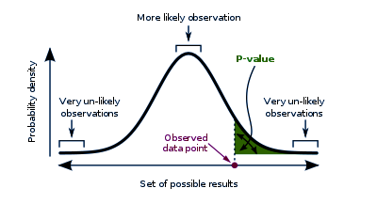
p-Value
The probability that, when the null hypothesis is true, the statistical summary is equal to or greater than the actual observed results.
https://data-flair.training/blogs/python-statistics/
Notes:
A smaller p-value means that the null hypothesis may not explain the observation well.

Slide 81
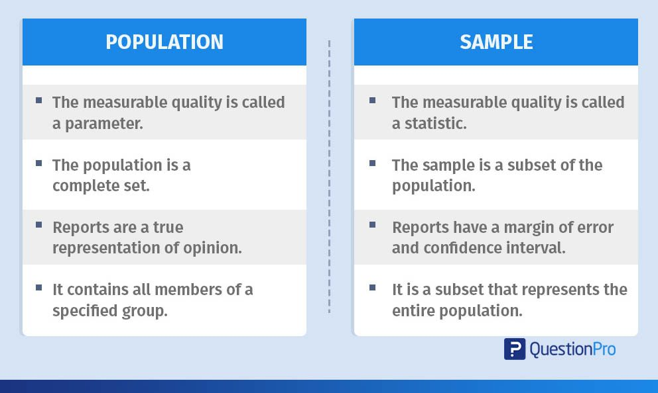
Notes:
A survey done of an entire population is accurate and more precise with no margin of error except human inaccuracy in responses. However, this may not be possible always.
The measurable characteristic of the population like the mean or standard deviation is known as the parameter. The parameter of the population is a numerical or measurable element that defines the system of the set.

Slide 82
Null vs. Alternative Hypothesis
Notes:
The null hypothesis reflects that there will be no observed effect in our experiment. The alternative hypothesis reflects that there will be an observed effect for our experiment.
The null hypothesis is what we attempt to find evidence against in our hypothesis test. The alternative hypothesis is what we are attempting to demonstrate in an indirect way by the use of our hypothesis test.
If the null hypothesis is rejected, then we accept the alternative hypothesis. If the null hypothesis is not rejected, then we do not accept the alternative hypothesis.
For example:
Null hypothesis: “x is equal to y.” Alternative hypothesis “x is not equal to y.”
Null hypothesis: “x is at least y.” Alternative hypothesis “x is less than y.”
Null hypothesis: “x is at most y.” Alternative hypothesis “x is greater than y.”

Slide 83
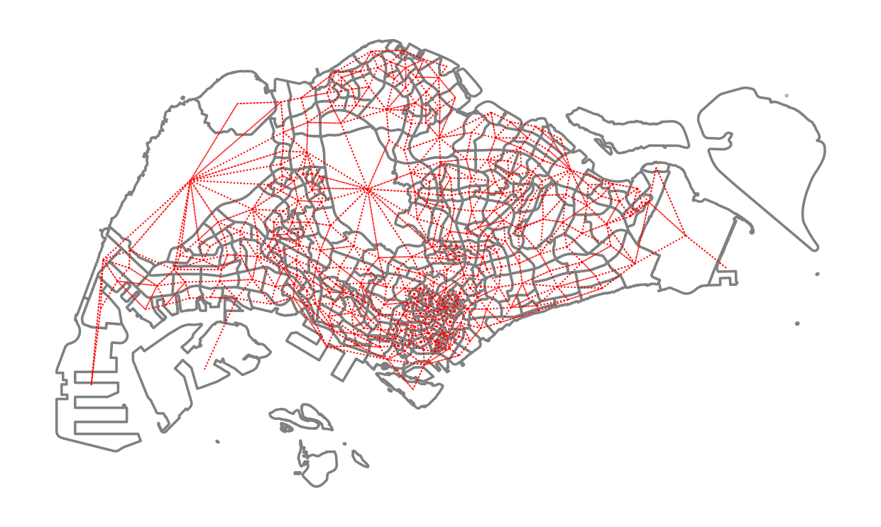
p-Value Example

Slide 84
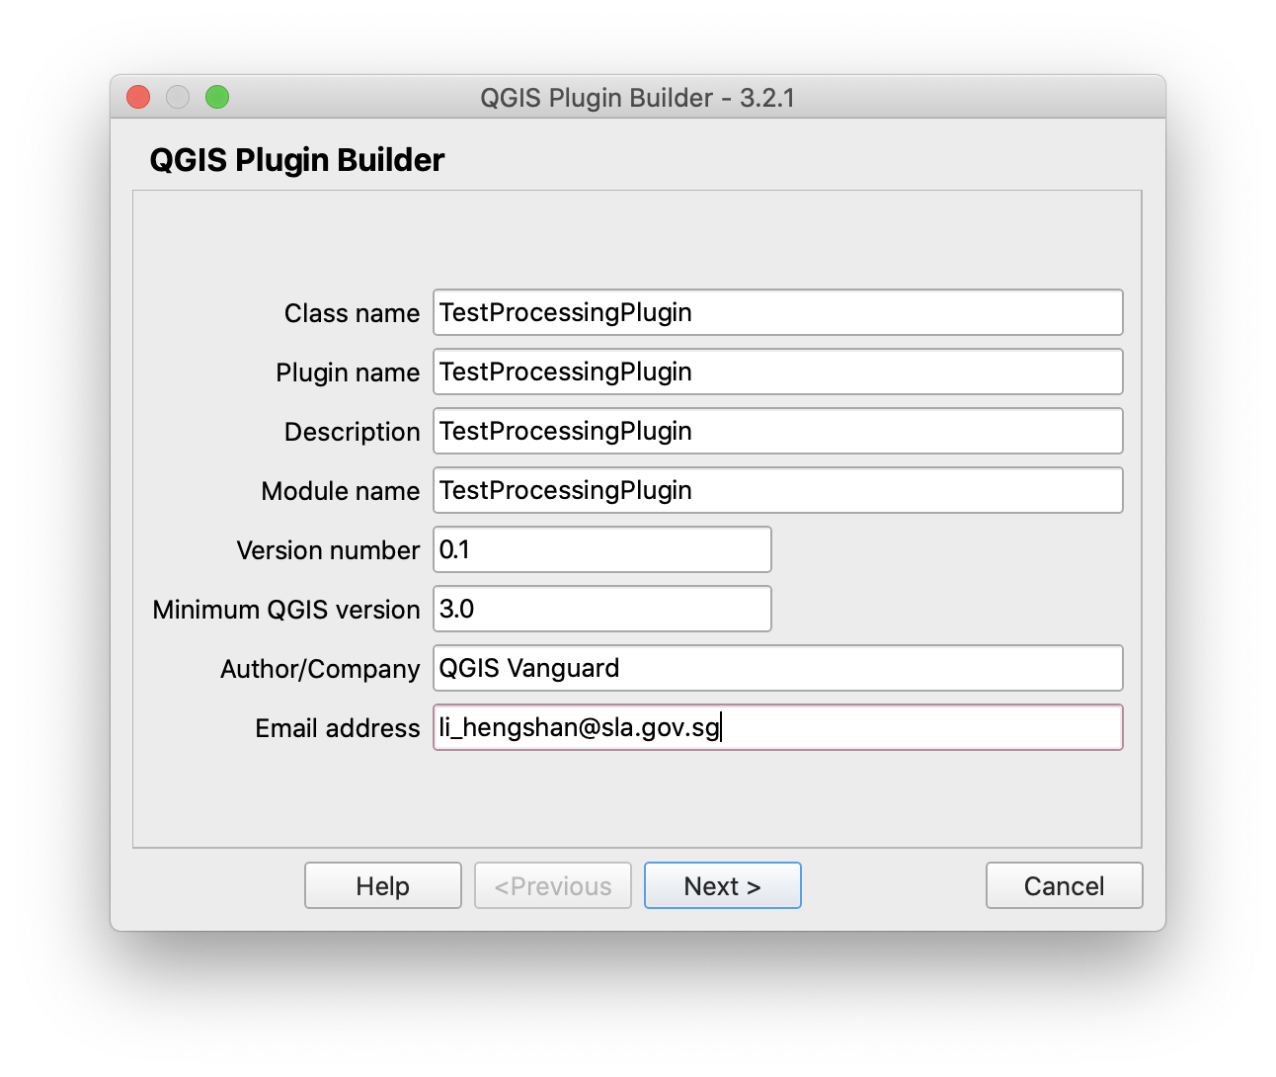
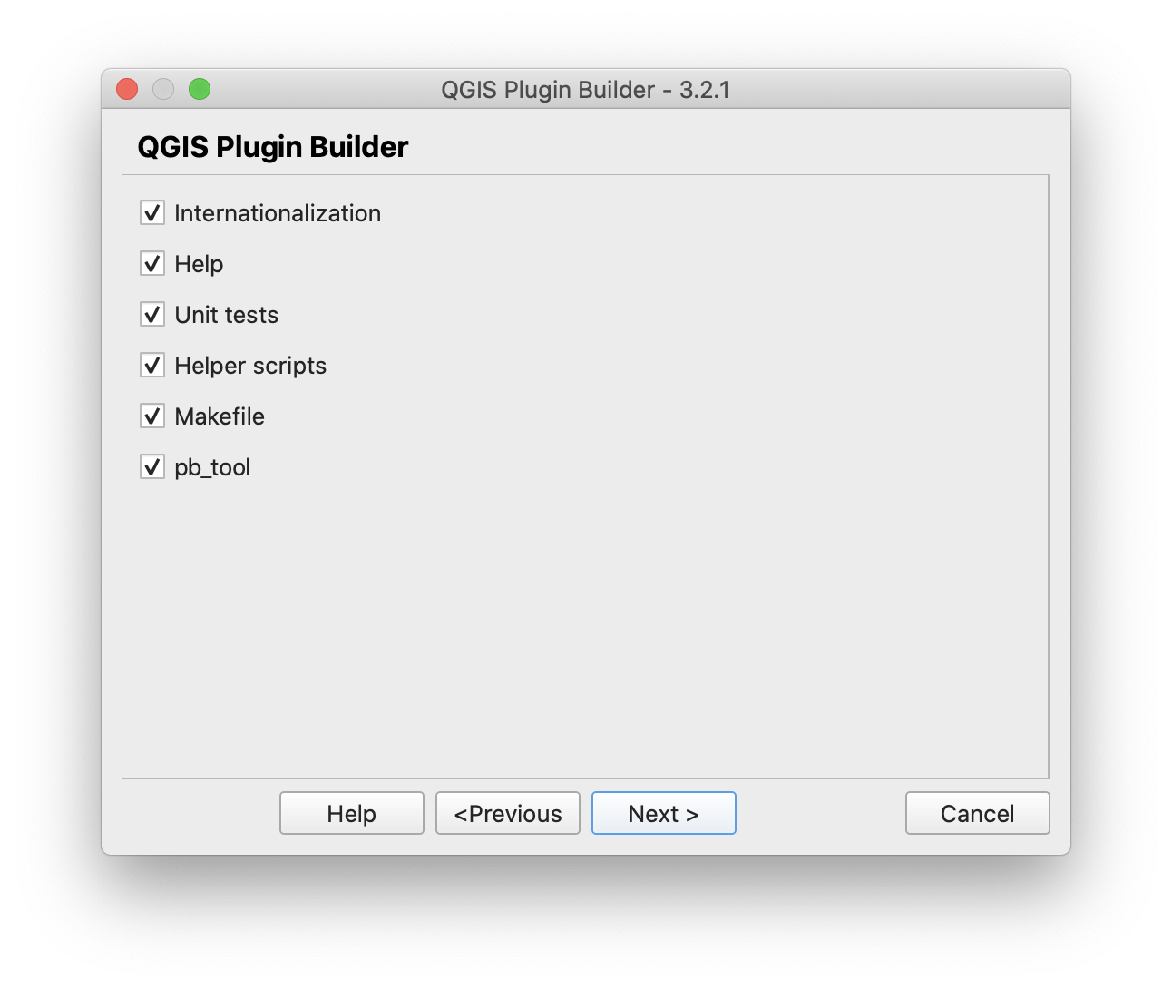
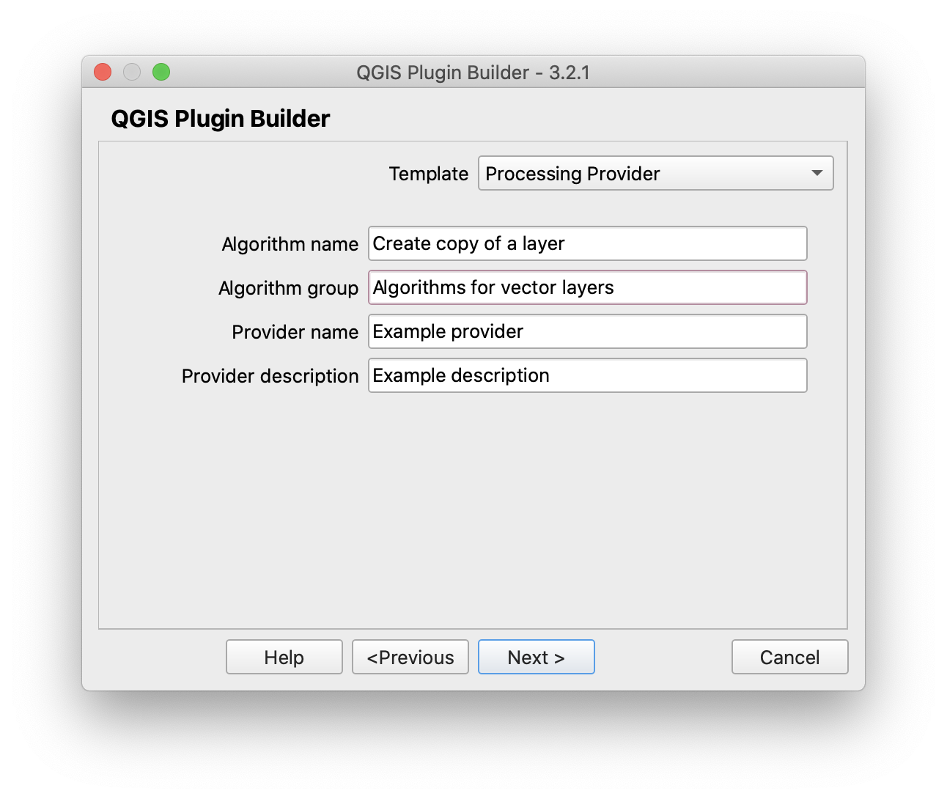
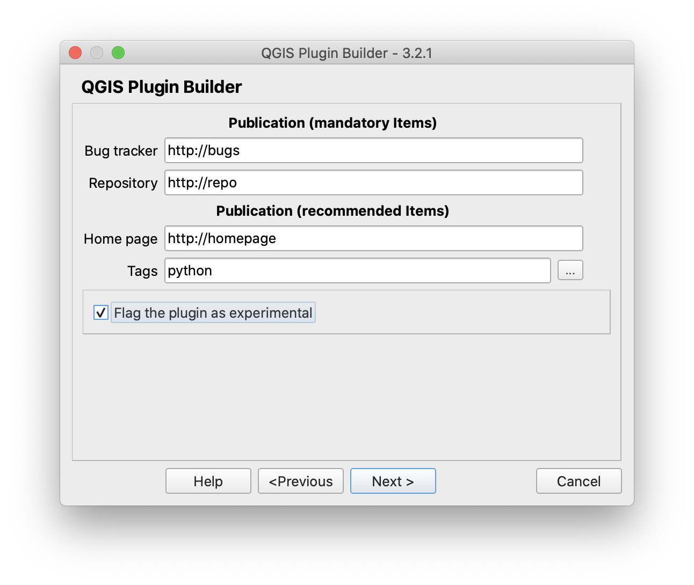

Slide 85
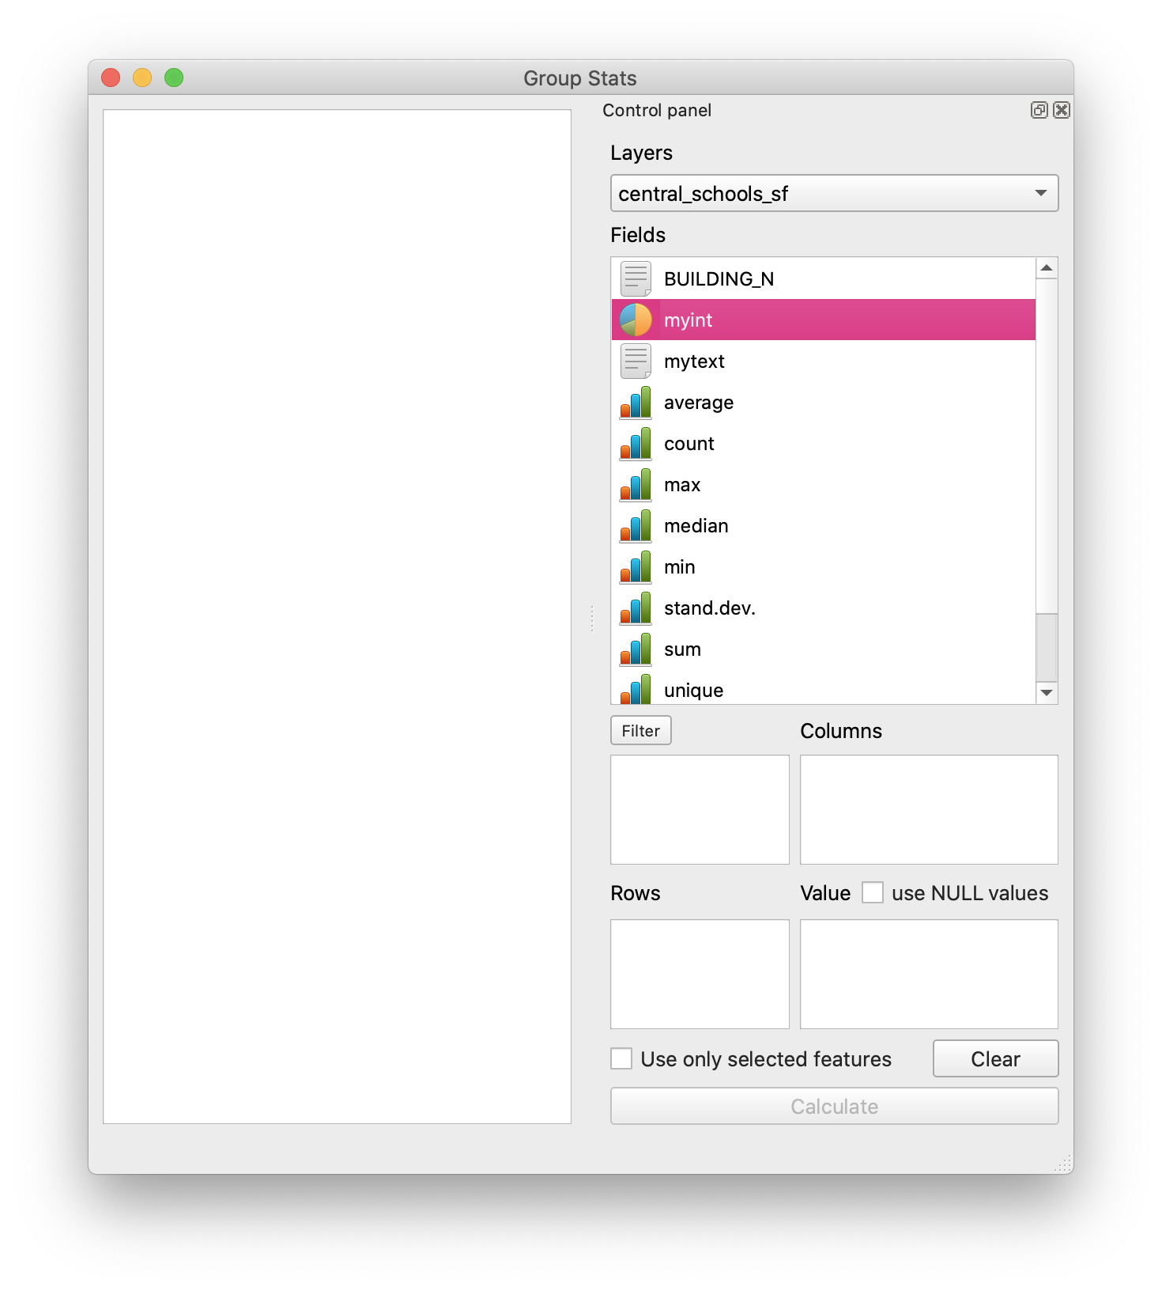
Building a Python Plugin
Plugins are a great way to extend the functionality of QGIS.
You can write plugins using Python that can range from adding a simple button to sophisticated toolkits.
Notes:
This tutorial will outline the process involved in setting up your development environment, designing the user interface for a plugin and writing code to interact with QGIS.

Slide 86
Plugin Folder Structure
PYTHON_PLUGINS_PATH/
MyPlugin/
__init__.py --> *required* . The starting point of the plugin. It has to have the classFactory() method.
mainPlugin.py --> *core code*
metadata.txt --> *required* Contains general info, version, name and some other metadata used by plugins website and plugin infrastructure.
resources.qrc --> *likely useful*
resources.py --> *compiled version, likely useful*
form.ui --> *likely useful*
form.py --> *compiled version, likely useful*
Notes:
__init__.py = The starting point of the plugin. It has to have the classFactory() method and may have any other initialisation code.
mainPlugin.py = The main working code of the plugin. Contains all the information about the actions of the plugin and the main code.
metadata.txt = Contains general info, version, name and some other metadata used by plugins website and plugin infrastructure.
resources.qrc = The .xml document created by Qt Designer. Contains relative paths to resources of the forms.
resources.py = The translation of the .qrc file described above to Python.
form.ui = The GUI created by Qt Designer.
form.py = The translation of the form.ui described above to Python.

Slide 87
__init__.py
def classFactory(iface):
from .mainPlugin import TestPlugin
return TestPlugin(iface)
Notes:
This file is required by Python’s import system. Also, QGIS requires that this file contains a classFactory() function, which is called when the plugin gets loaded into QGIS. It receives a reference to the instance of QgisInterface and must return an object of your plugin’s class from the mainplugin.py — in our case it’s called TestPlugin (see below). This is how __init__.py should look like

Slide 88
mainPlugin.py
from qgis.PyQt.QtGui import *
from qgis.PyQt.QtWidgets import *
# initialize Qt resources from file resources.py
from . import resources
class TestPlugin:
def __init__(self, iface):
# save reference to the QGIS interface
self.iface = iface
def initGui(self):
# create action that will start plugin configuration self.action = QAction(QIcon(":/plugins/testplug/icon.png"), "Test plugin", self.iface.mainWindow()) self.action.setObjectName("testAction")

Slide 89
mainPlugin.py
self.action.setStatusTip("This is status tip")
self.action.triggered.connect(self.run)
self.iface.addToolBarIcon(self.action)
self.iface.addPluginToMenu("&Test plugins", self.action)
self.iface.mapCanvas().renderComplete.connect(self.renderTest)
def unload(self):
self.iface.removePluginMenu("&Test plugins", self.action)
self.iface.removeToolBarIcon(self.action)
self.iface.mapCanvas().renderComplete.disconnect(self.renderTest)
def run(self):
print("TestPlugin: run called!")
def renderTest(self, painter):
print("TestPlugin: renderTest called!"))

Slide 90



Slide 91


Slide 92


Slide 93



Slide 94








Slide 95


